Slide 1

STUDIA PODYPLOMOWE
POLITECHNIKA BIAŁOSTOCKA
JavaScript

Slide 2
#4

Slide 3
Previously on JS
Declaring variables
Objects
Functional programming with arrays

Slide 4
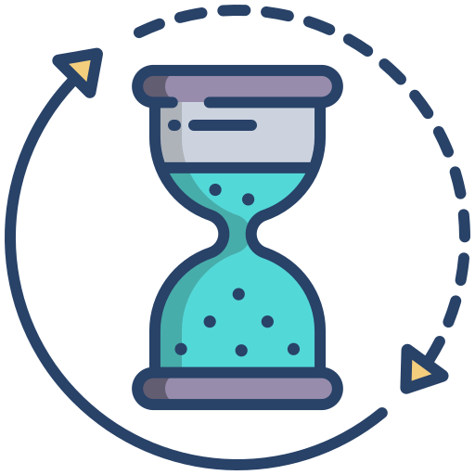
ASYNCHRONOUS JAVASCRIPT

Slide 5
Synchronous vs asynchronous
Up until now, the only way we know is synchronous
Each line of code runs one after another
In real-life web apps - rarely the case
We wait for many things in our applications - how to deal with them in code?

Slide 6

JavaScript engine main parts
Memory Heap
Call stack
Thread of execution
Memory
Call stack

Slide 7
JavaScript principles
Thread of execution - goes line by line through the code and executes each line
Memory - place where all ‘data’ (strings, arrays, etc.) are saved
Call stack - keeps track of what function is currently running (tells you where currently is the thread of execution)

Slide 8
Call stack
When function is run - add (push) to call stack
When function finish running - remove (pop) it from call stack
Whatever is top of the call stack - currently running function
LIFO - last in, first out - last function is always the first one out of the stack

Slide 9
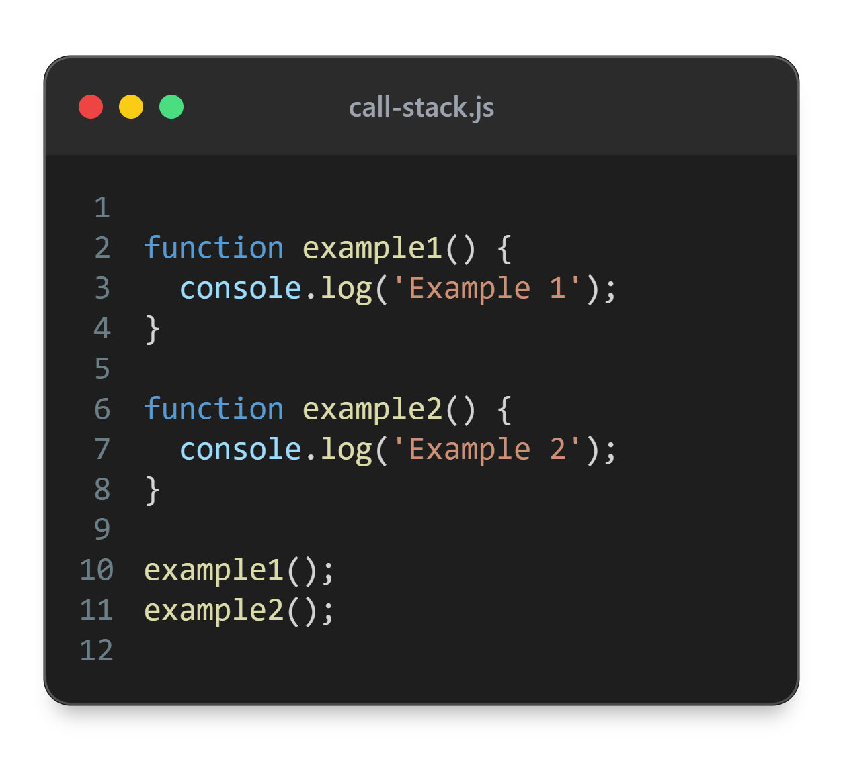
Call Stack
console.log()
example1()
example2()
global()

Slide 10
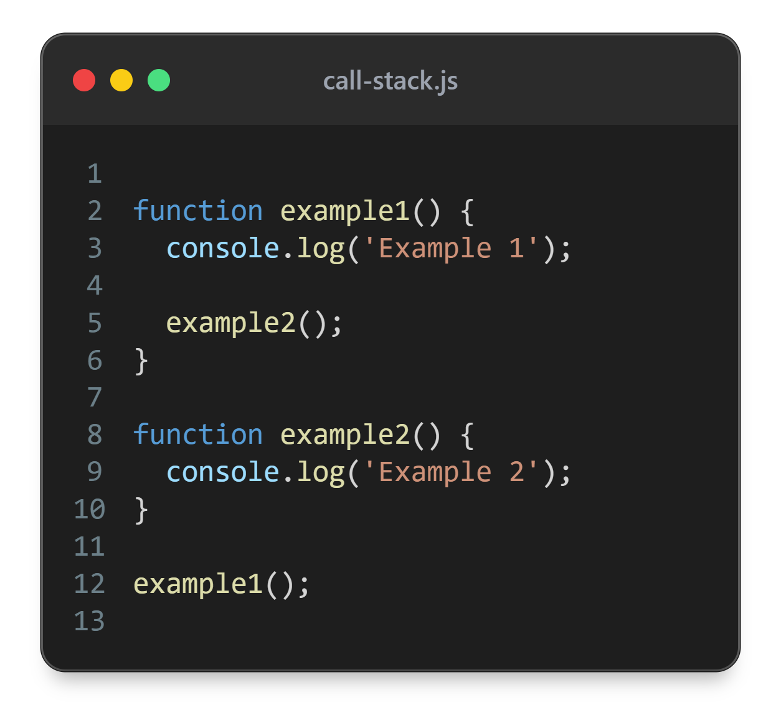
Call Stack
console.log()
console.log()
example2()
example1()
global()

Slide 11
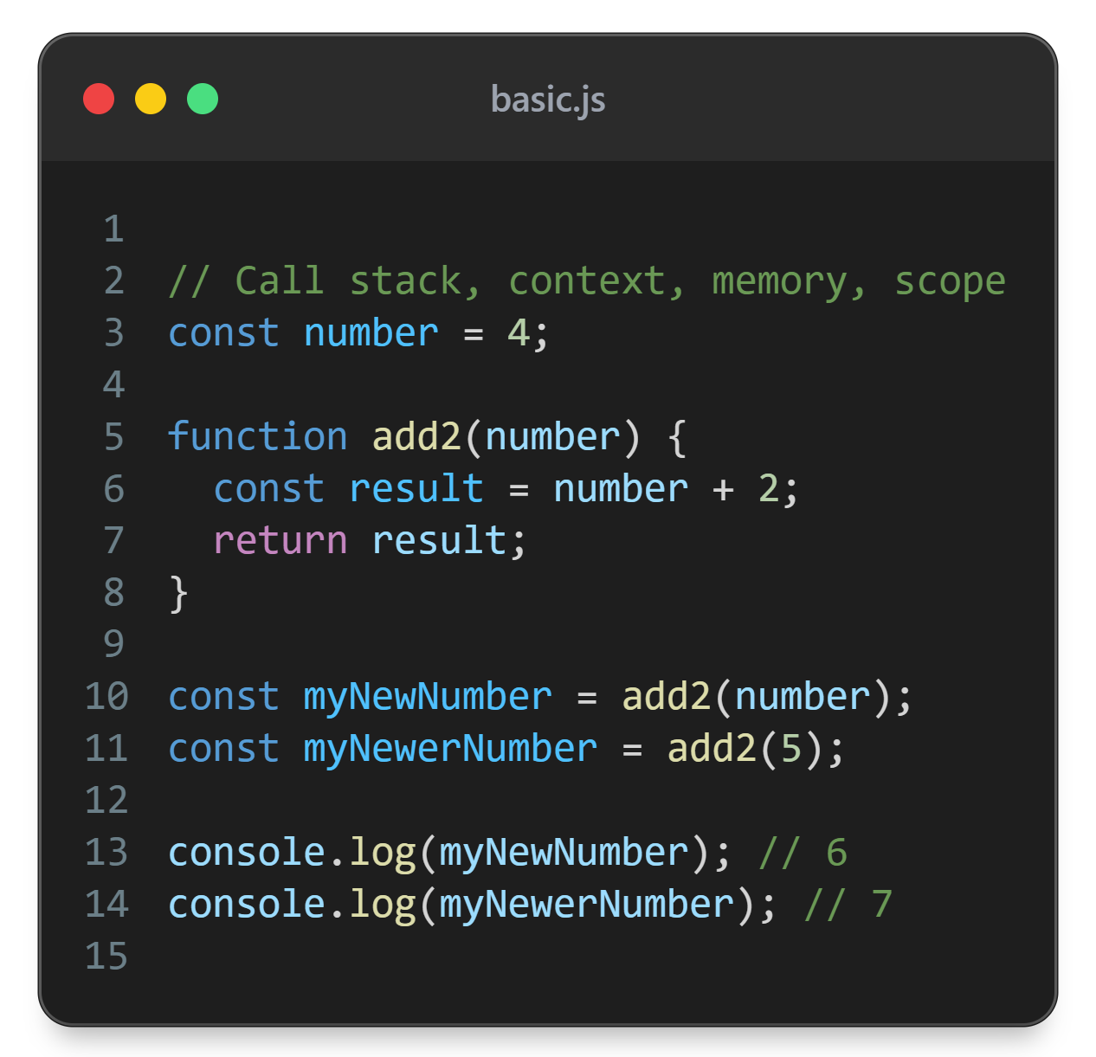

myNewNumber = add2(number)
Global memory
Local memory
number
4
number
4
result
6
add2
return 6
myNewNumber
6
myNewerNumber = add2(5)
myNewerNumber
7
Local memory
number
5
result
7
return 7

Slide 12
Synchronous code block example
DEMO

Slide 13
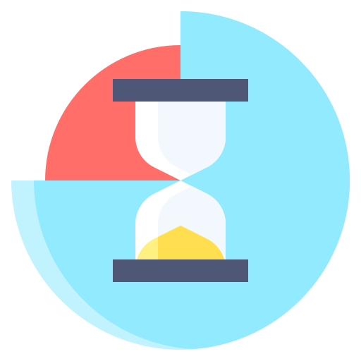
setTimeout

Slide 14
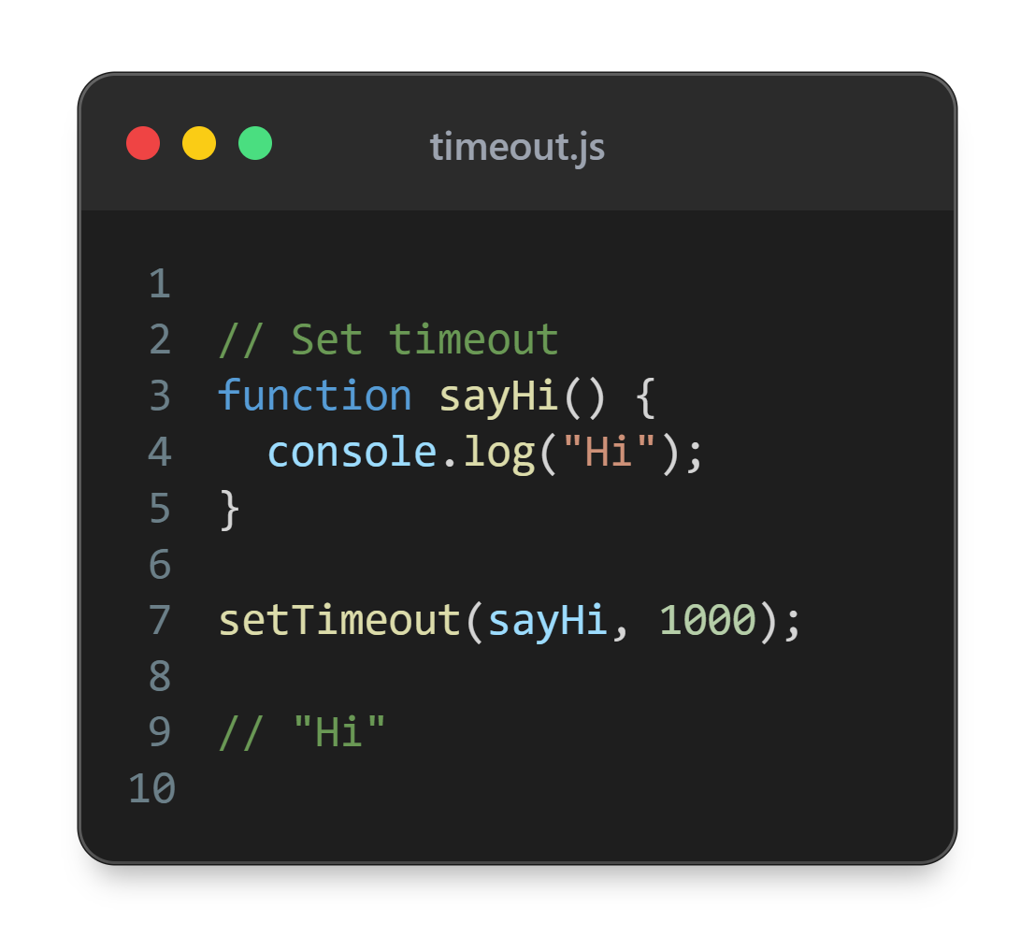

Slide 15
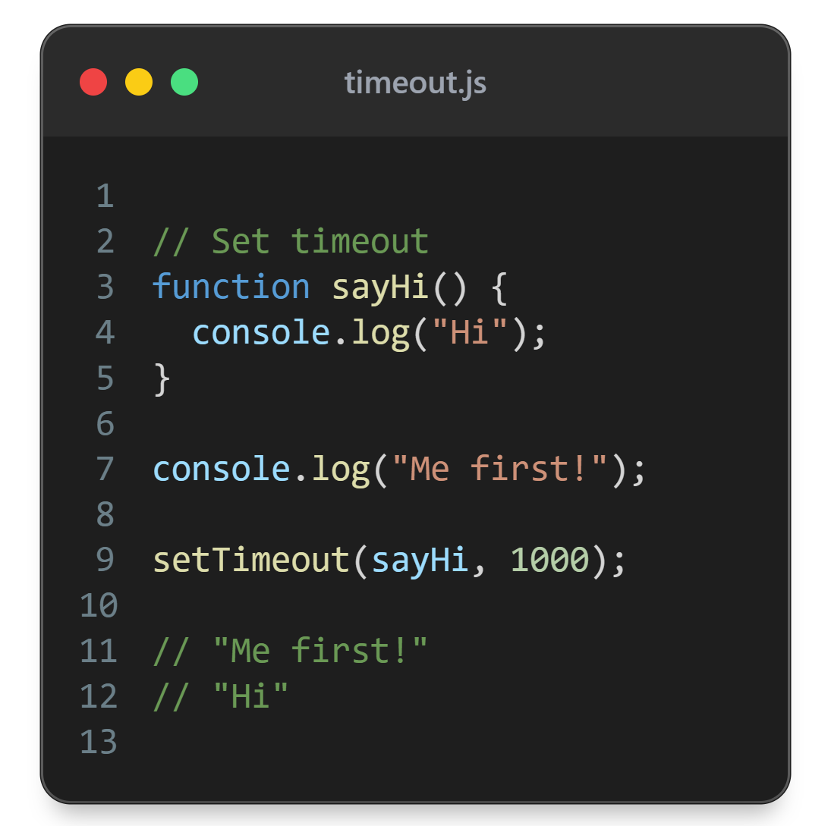

Slide 16
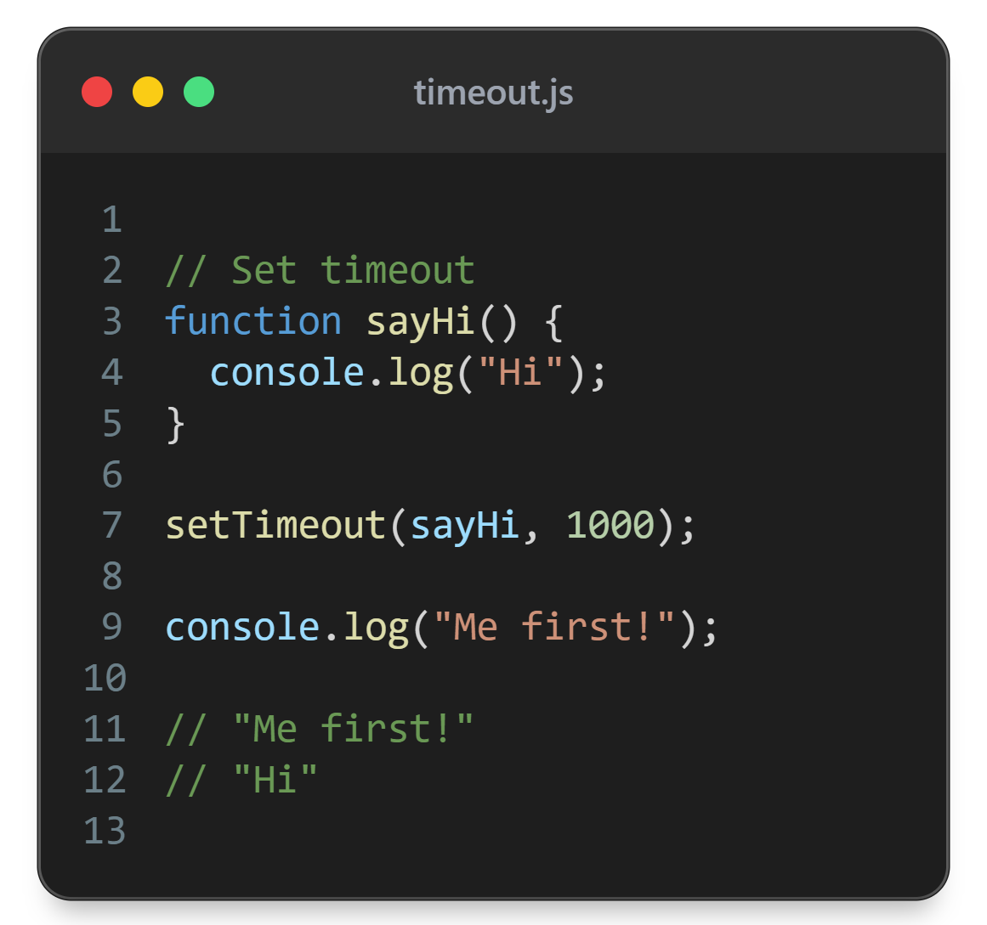

Slide 17
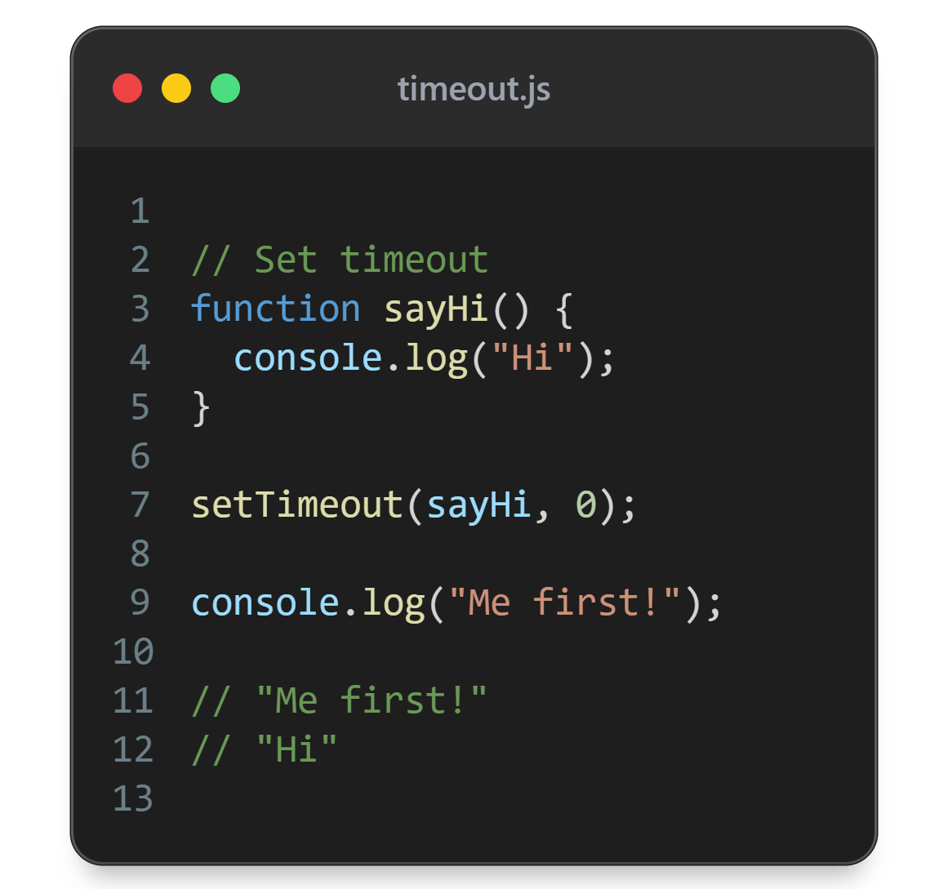

Slide 18
Facade functions
Act as a gateway to browser/node features
Allow using features like:
  network requests
  timer
  manipulate DOM
  many more…

Slide 19
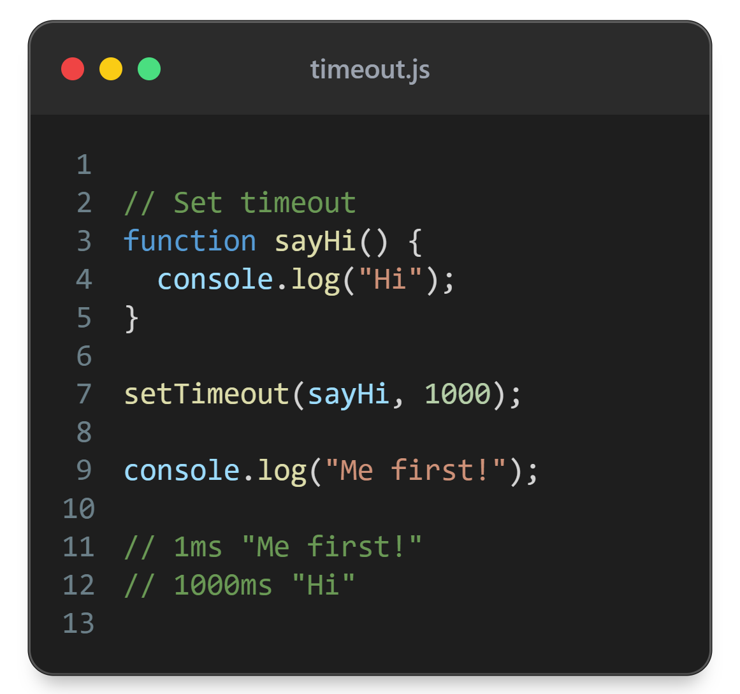
0ms
setTimeout(sayHi, 1000)
Global memory
sayHi
1ms
console.log(“Me first!”)
1000ms
sayHi()
Callstack
Web Browser Features
complete?
on completion
timer
0ms - NO
sayHi
console.log()
setTimeout()
1000ms - YES
console.log()
sayHi()
1000ms
global()

Slide 20
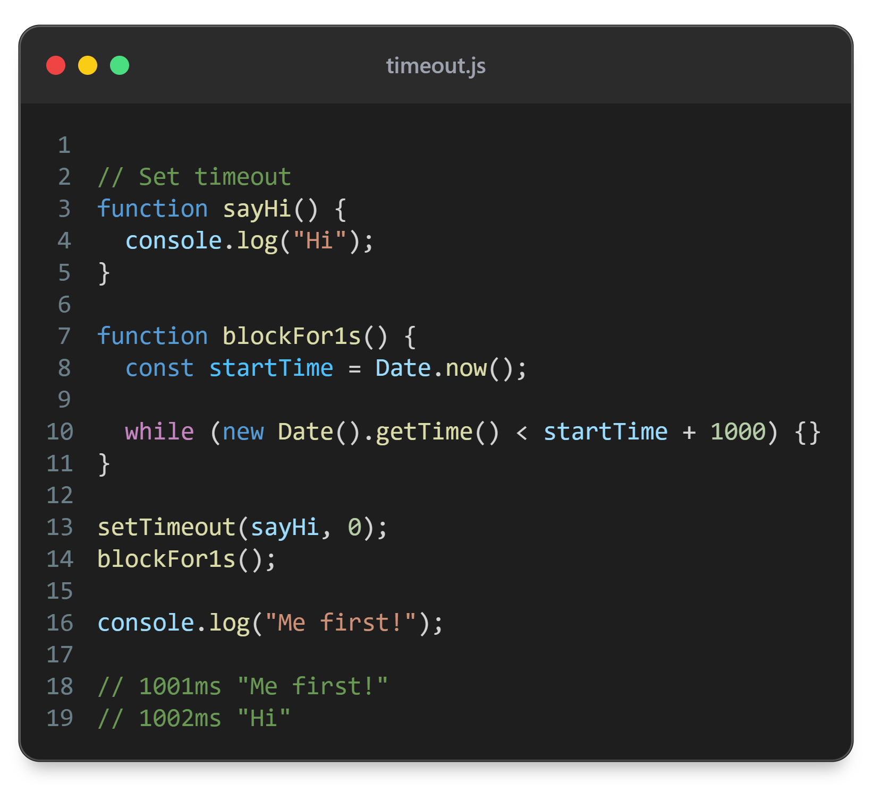

Slide 21
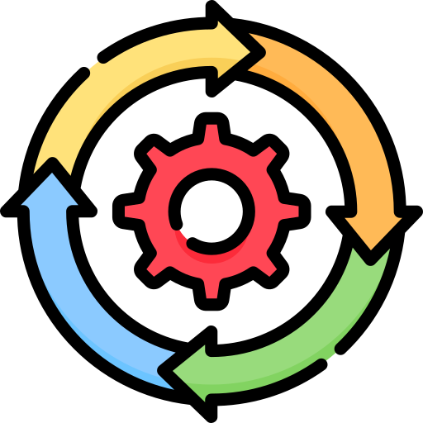
0ms
setTimeout(sayHi, 0)
Global memory
1ms
blockFor1s()
sayHi
blockFor1s
1001ms
console.log(“Me first”)
1002ms
sayHi()
Callstack
Web Browser Features
complete?
on completion
Callback queue
timer
0ms - YES
sayHi
setTimeout()
sayHi
0ms
blockFor1s()
console.log()
sayHi()
global()

Slide 22
Callback queue and Event loop
Asynchronous functions calls (called by browser/node) are put into queues - one of theme is the callback queue
They wait until all the synchronous code finishes
Event loop is a mechanism for checking if the call stack is empty

Slide 23
Asynchronous JavaScript
Before any asynchronous code is run:
  JavaScript needs to finish executing all synchronous code
  The call stack needs to be empty

Slide 24

Promises

Slide 25
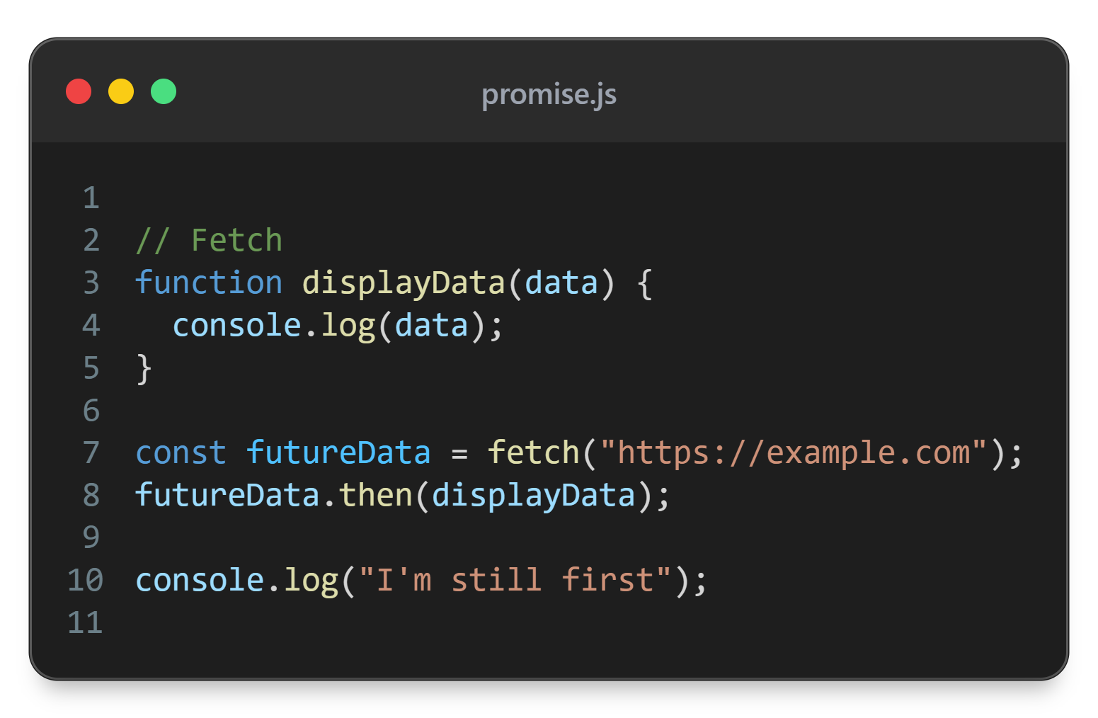

Slide 26

0ms
fetch(‘https://example.com’)
Global memory
display
Data
future
Data
futureData.then(displayData)
1ms
value: …
Hi
2ms
console.log(“I’m still first”)
onFulfilled:
[ ]
displayData(Hi)
displayData
235ms
Callstack
Web Browser Features
complete?
on completion
Microtack queue
network
request
0ms - NO
futureData.value
Hi
fetch()
235ms - YES
displayData(“Hi”)
global()

Slide 27
fetch()
Facade function that has both effect in JS and browser/node
In browser - runs network request
In JS - creates a Promise object

Slide 28
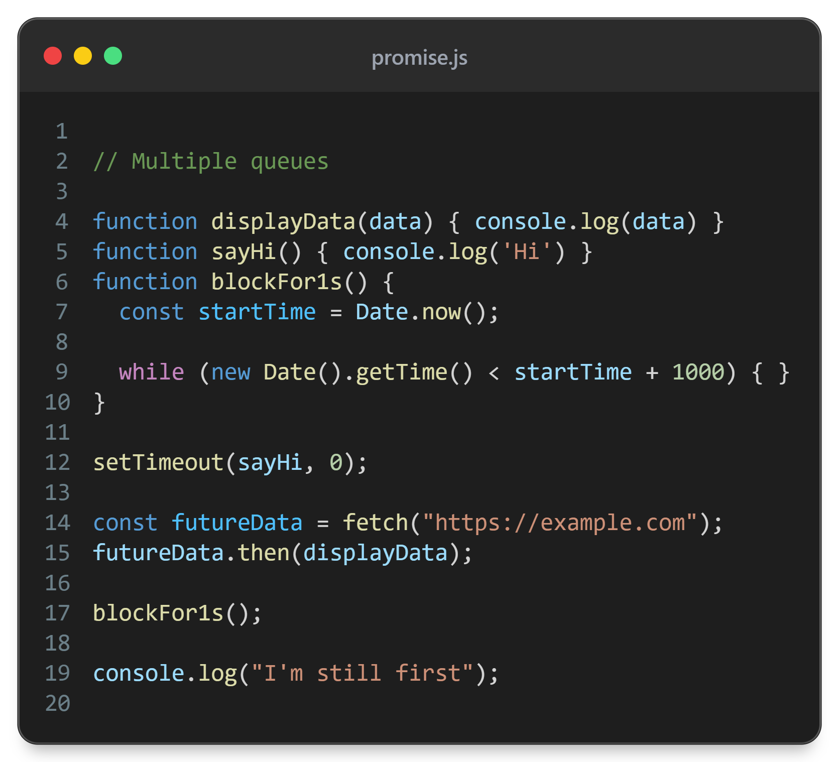

Slide 29
0ms
setTimeout(sayHi, 0)
Global memory
display
Data
1ms
fetch(‘https://example.com’)
sayHi
blockFor1s
futureData.then(displayData)
future
Data
2ms
3ms
blockFor1s()
value: …
Hi
1003ms
console.log(“I’m still first”)
onFulfilled:
[ ]
Callstack
1004ms
displayData(Hi)
displayData
Callback queue
1005ms
sayHi(Hi)
sayHi
Web Browser Features
complete?
on completion
Microtack queue
timer
0ms - YES
sayHi
0ms
setTimeout()
1ms - NO
futureData.value
fetch()
blockFor1s()
displayData(“Hi”)
sayHi()
network
request
Hi
global()
displayData
235ms - YES

Slide 30
Queues
Promises end up in the microtask queue
Callback queue (task queue) is for facade functions using callback
There are more queues - in practice - you probably don’t need to worry about that

Slide 31
Promise
Promise - subtype of object
Hidden property state: pending, fulfilled, rejected
Hidden property result - initially undefined

Slide 32
Promise - fulfilled
Hidden properties: value, onFulfilled
With .then we can put functions in onFulfilled array
Those functions will be run when the promise is fulfilled with value inserted in the first of the functions
Result of the previous function will be inserted as and argument for any subsequent function in onFullfilled array

Slide 33
Promise - rejected
Hidden properties: value, onRejected
With .catch we can put function in onRejected
This function will be run if the promise is rejected with reason inserted as an argument
That would usually be an error

Slide 34
state: “fulfilled”
result: “done”
resolve(“done”)
state: “pending”
result: undefined
reject(error)
state: “rejected”
result: error

Slide 35
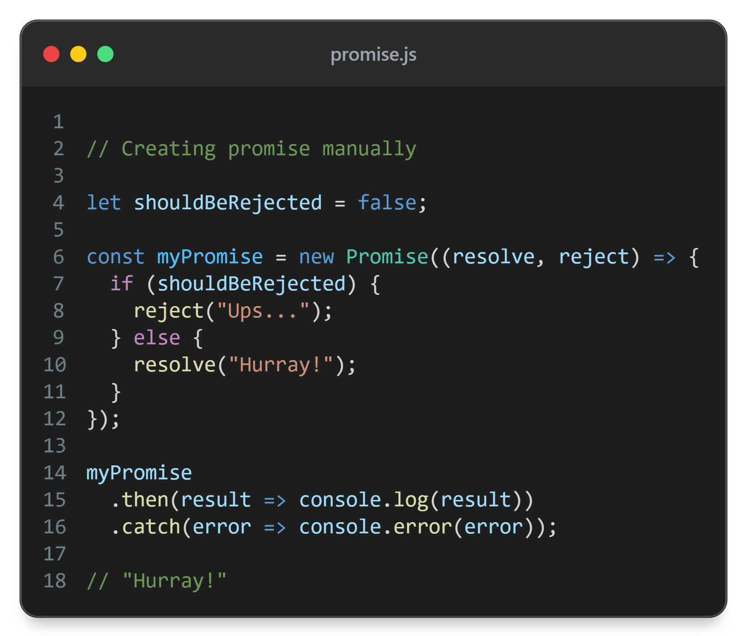

Slide 36
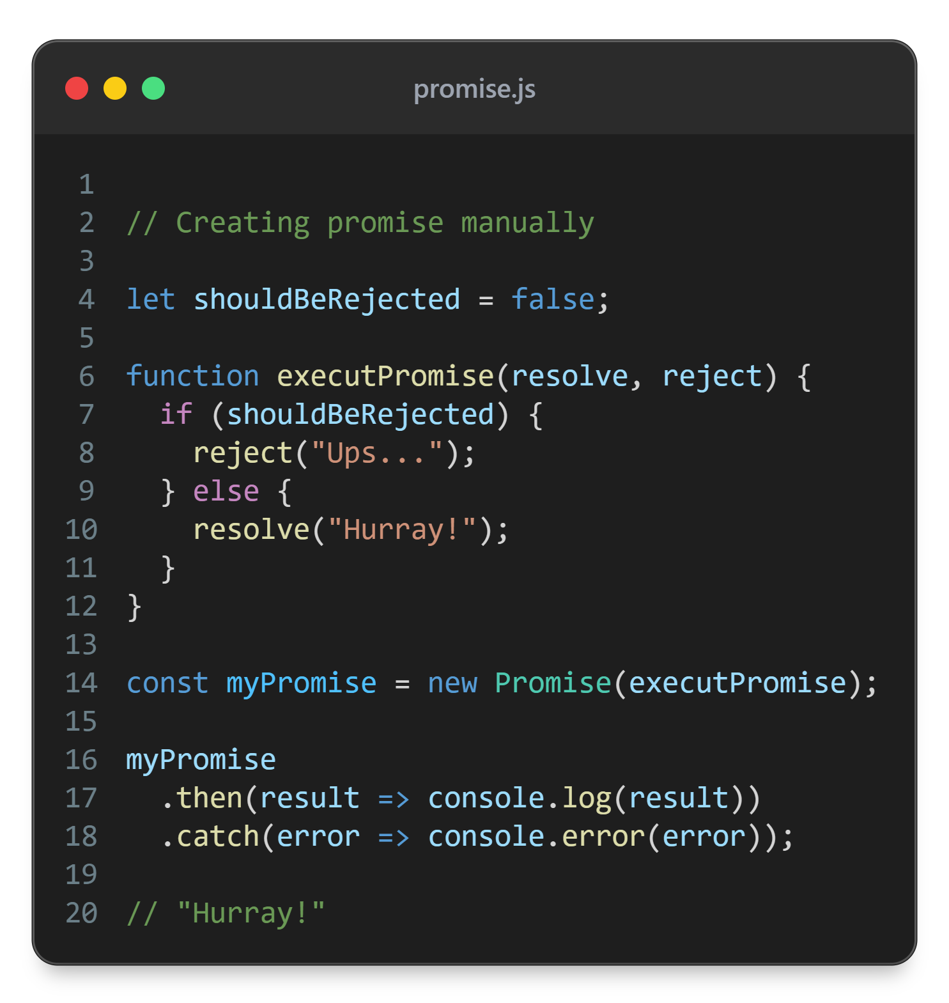

Slide 37
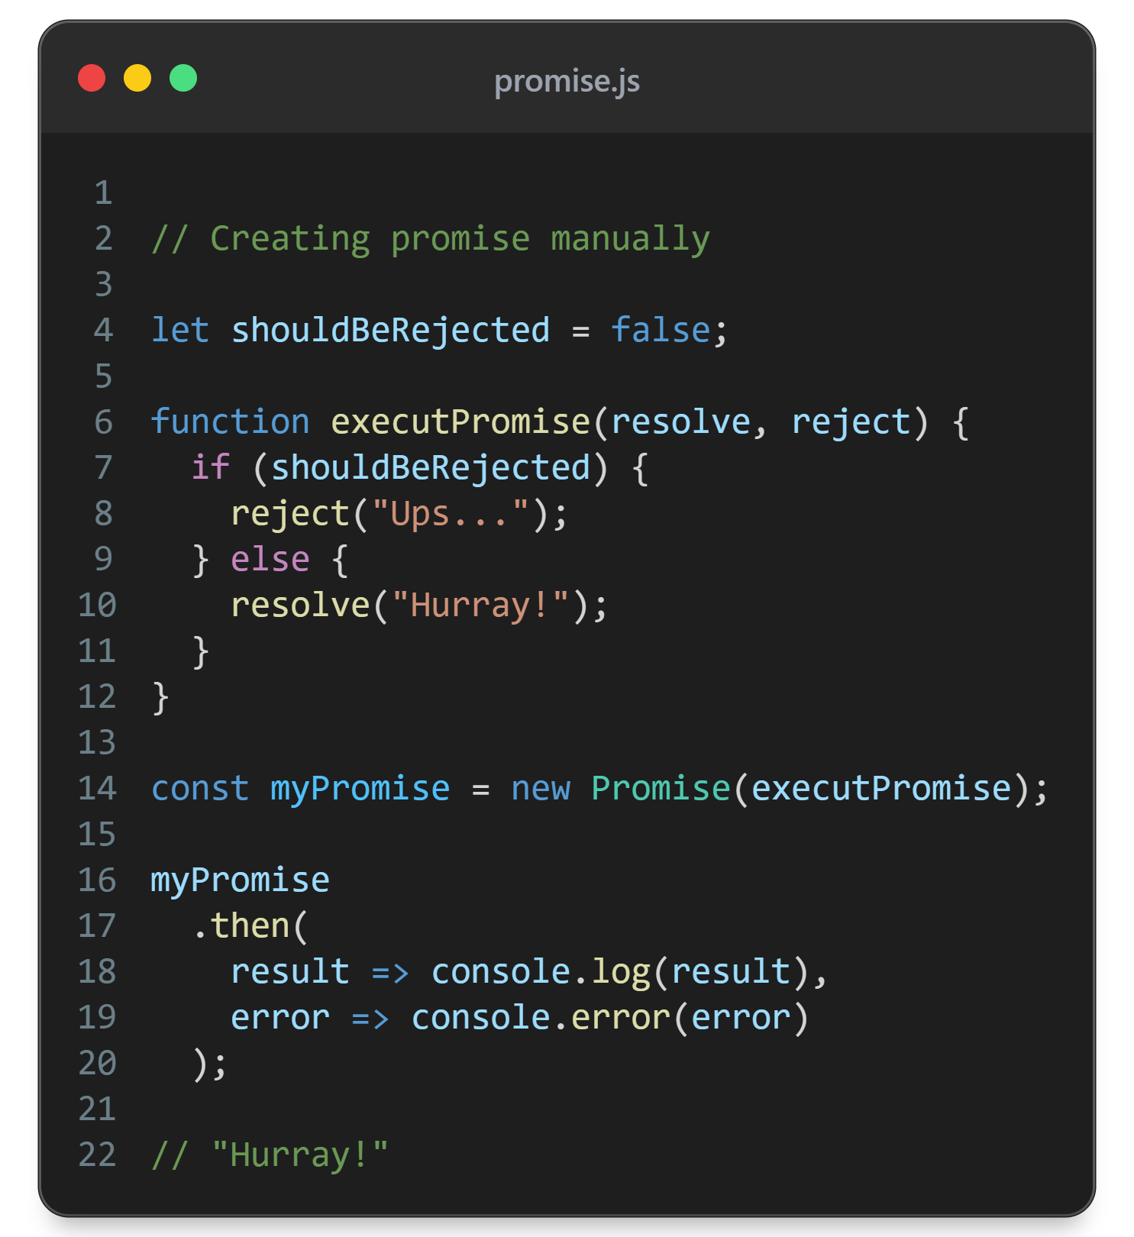

Slide 38
Promise example
DEMO

Slide 39
Promise.all()
Takes in an array of promises
Returns a promise, that resolves when all the promises in the array resolve
The returned promise value will be an array of all of the input promises values
Allows for multiple tasks to run in parallel

Slide 40
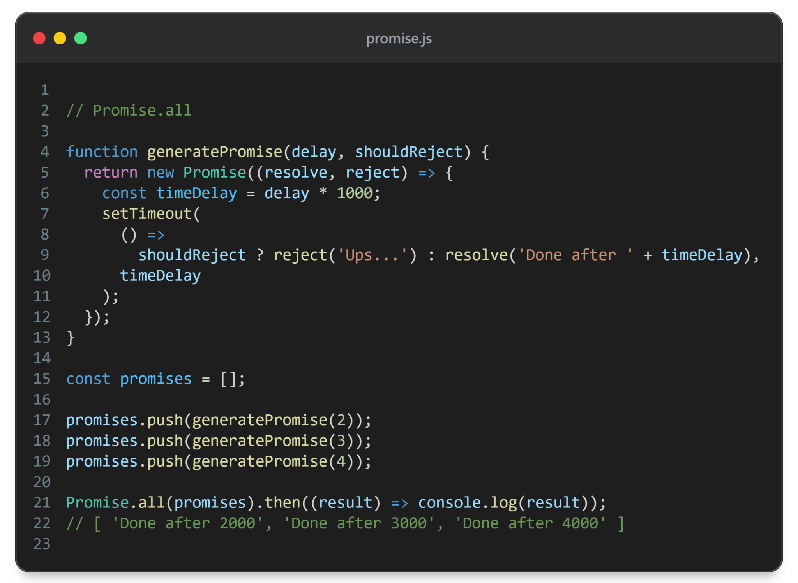

Slide 41
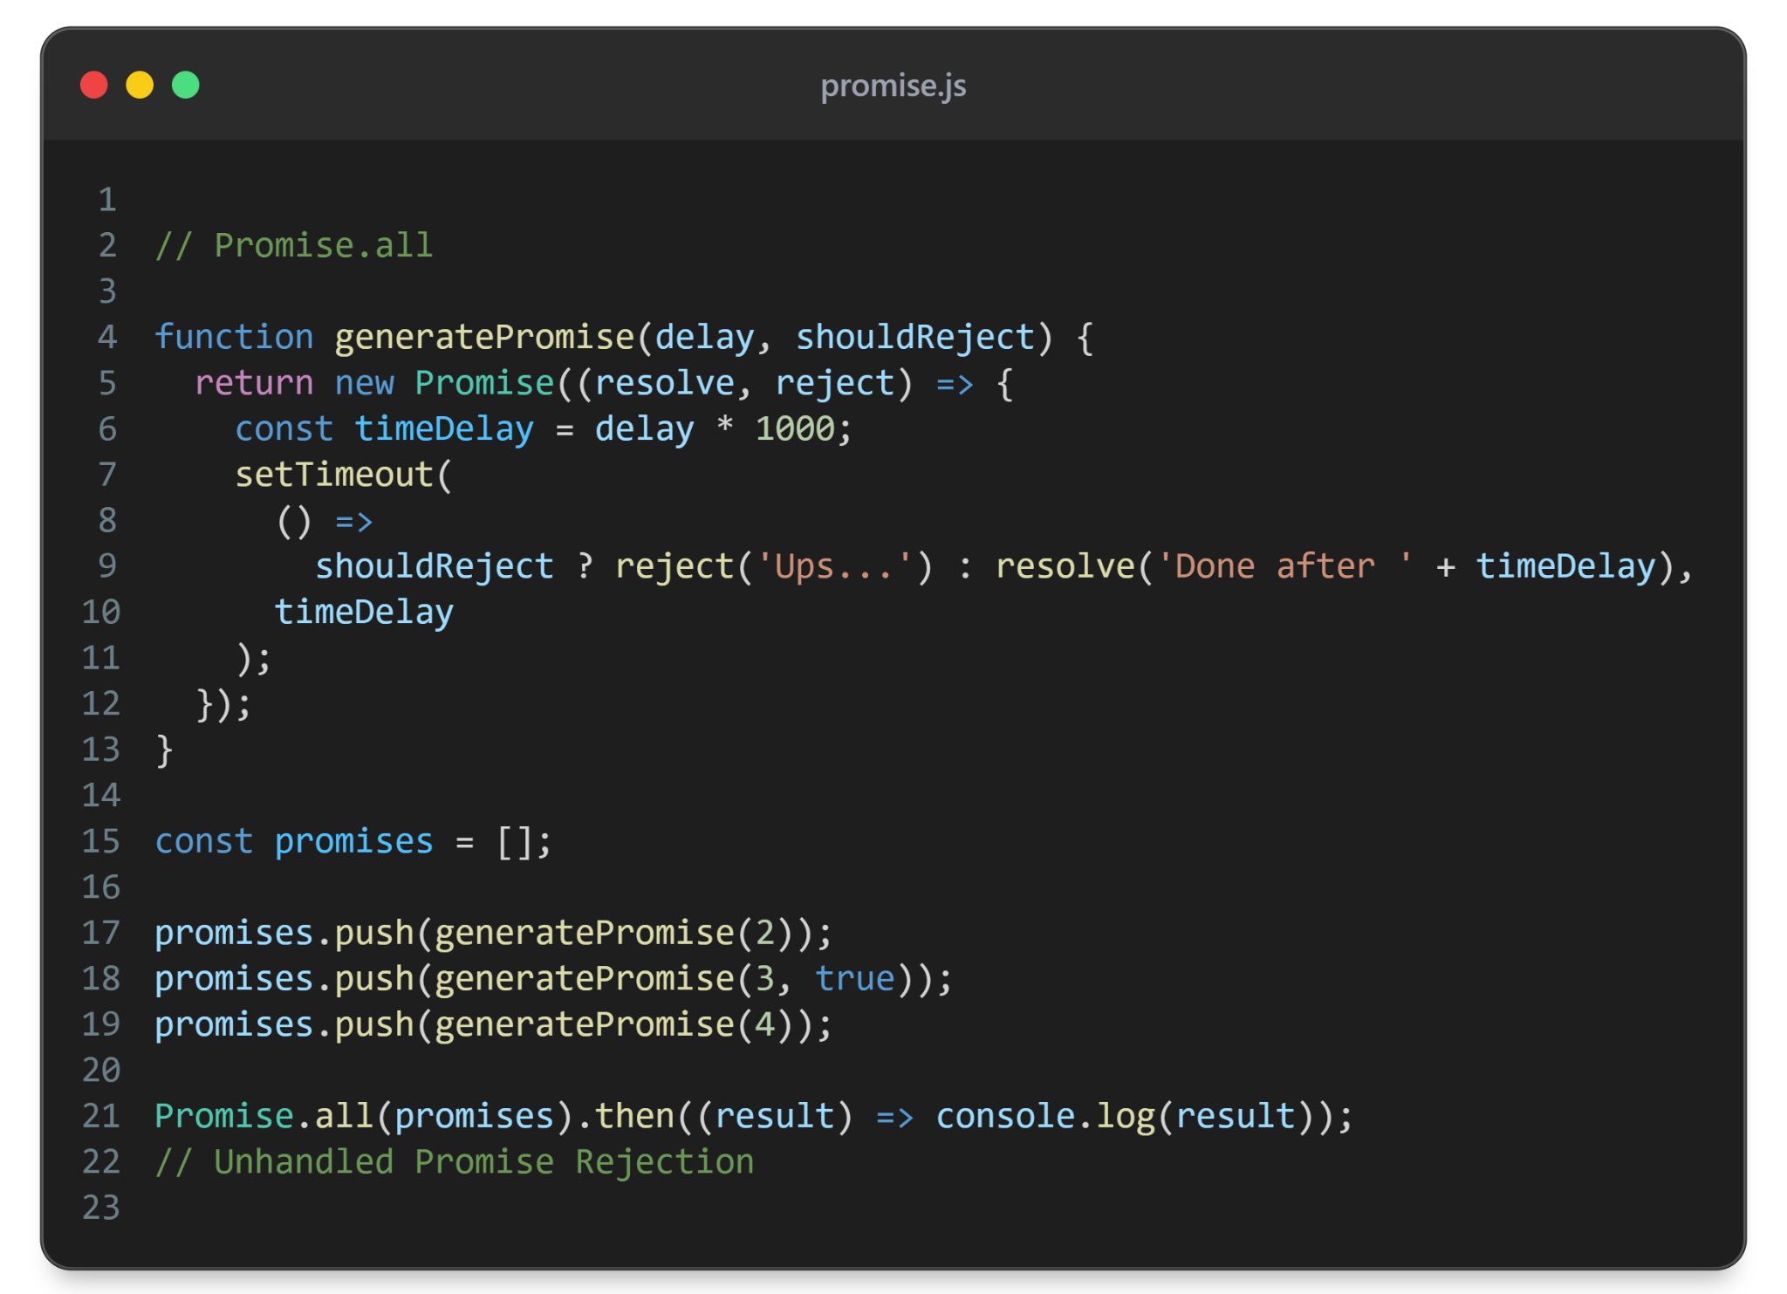

Slide 42
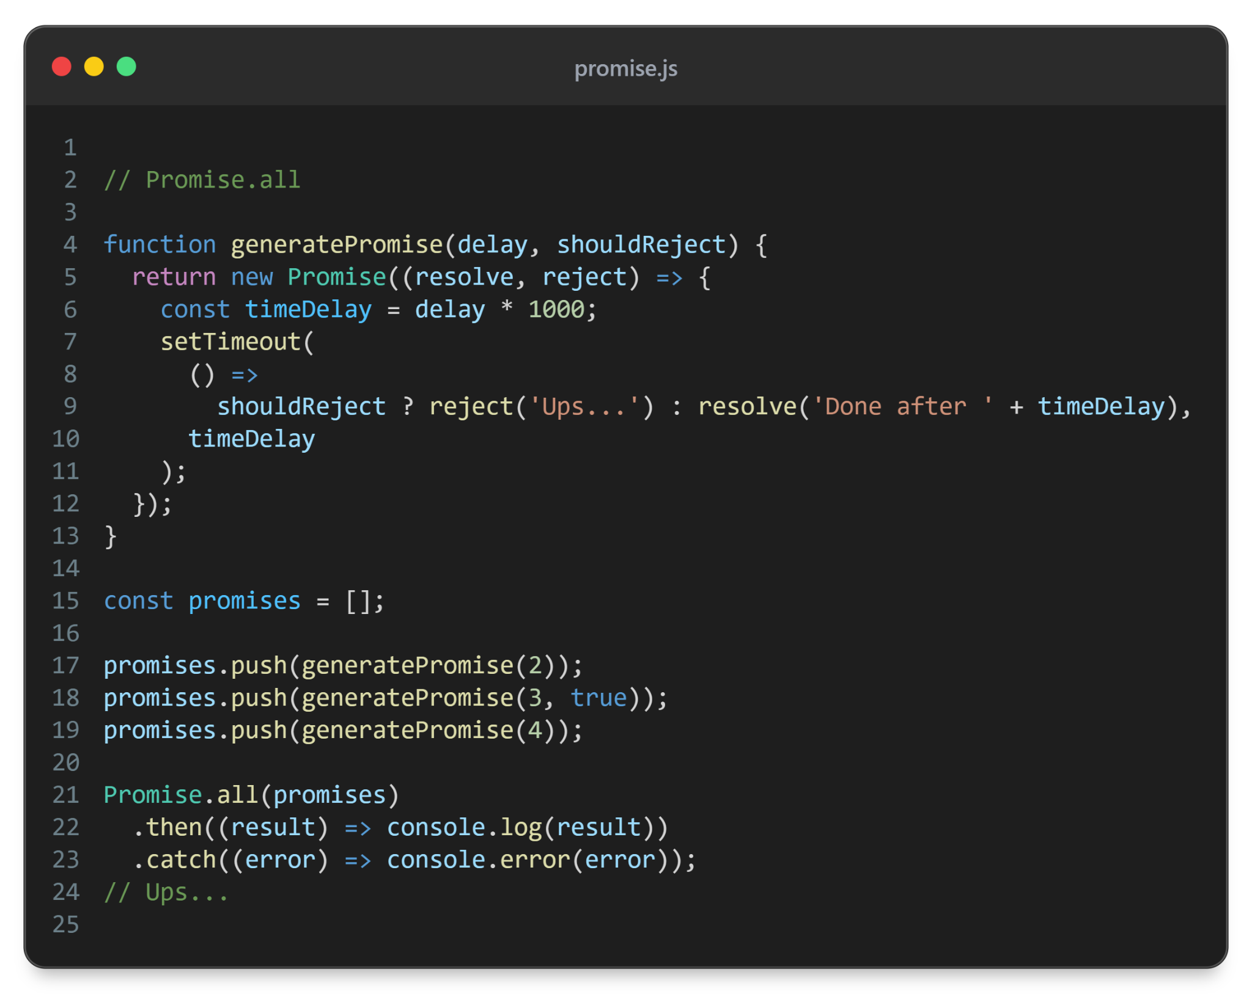

Slide 43
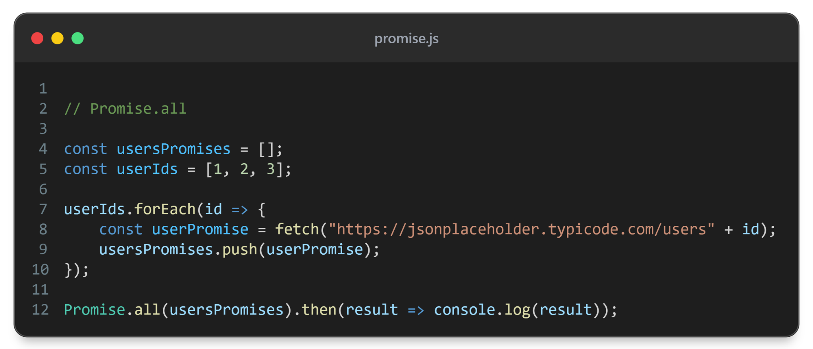

Slide 44
Promise.all example
DEMO

Slide 45
Promise.any()
Takes in an array of promises
Returns a promise, that resolves when any of the promises in the array resolve
The returned promise value will be the first resolved promise
Allows for multiple tasks to run in parallel
Rejects when all promises reject - returns AggregateError

Slide 46
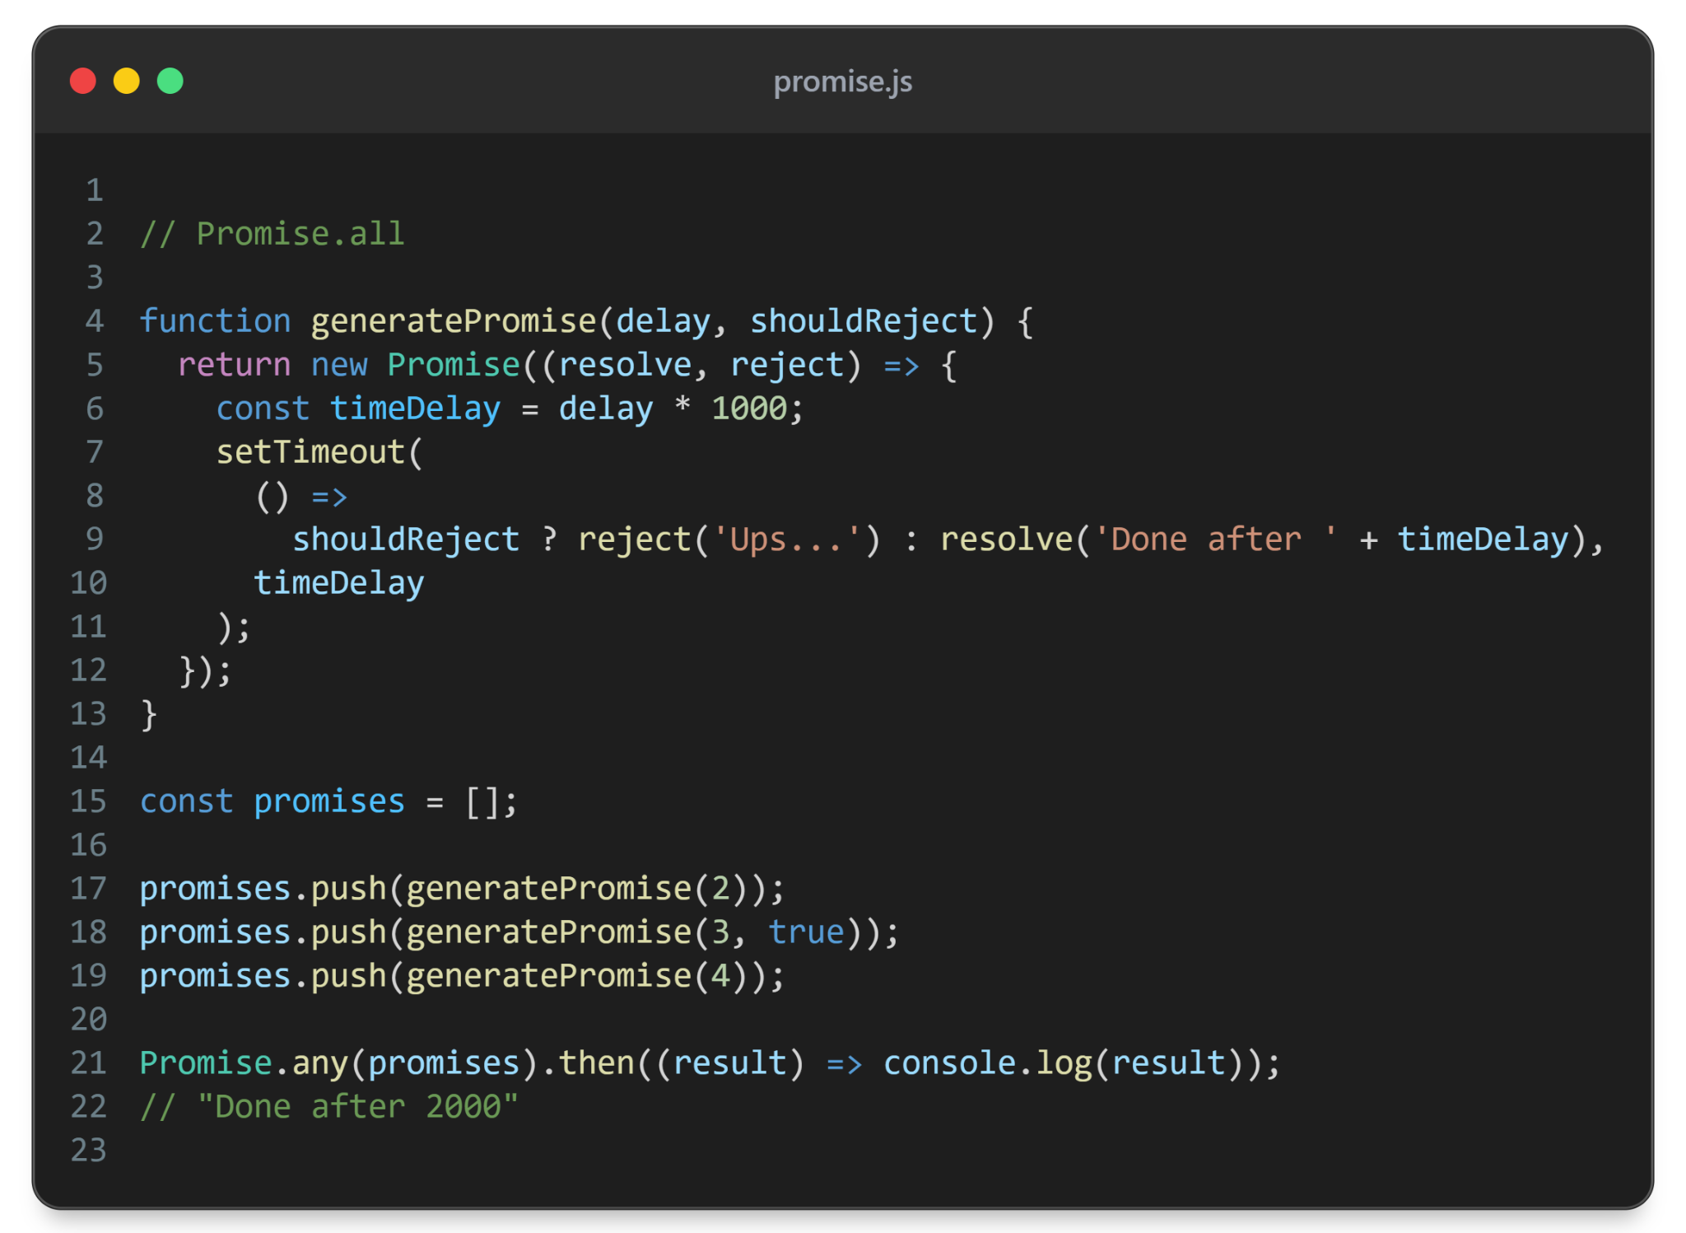

Slide 47
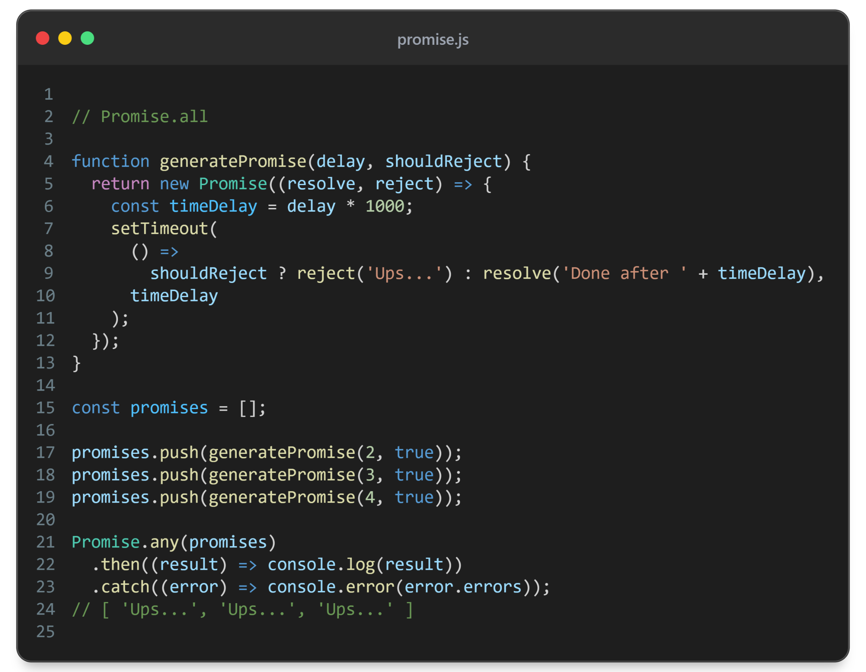

Slide 48
Promise.race()
Takes in an array of promises
Returns a promise, that resolves/rejects when the first of the promises in the array resolve/reject
Returned promise’s value will be the same as the first resolved of input promises

Slide 49
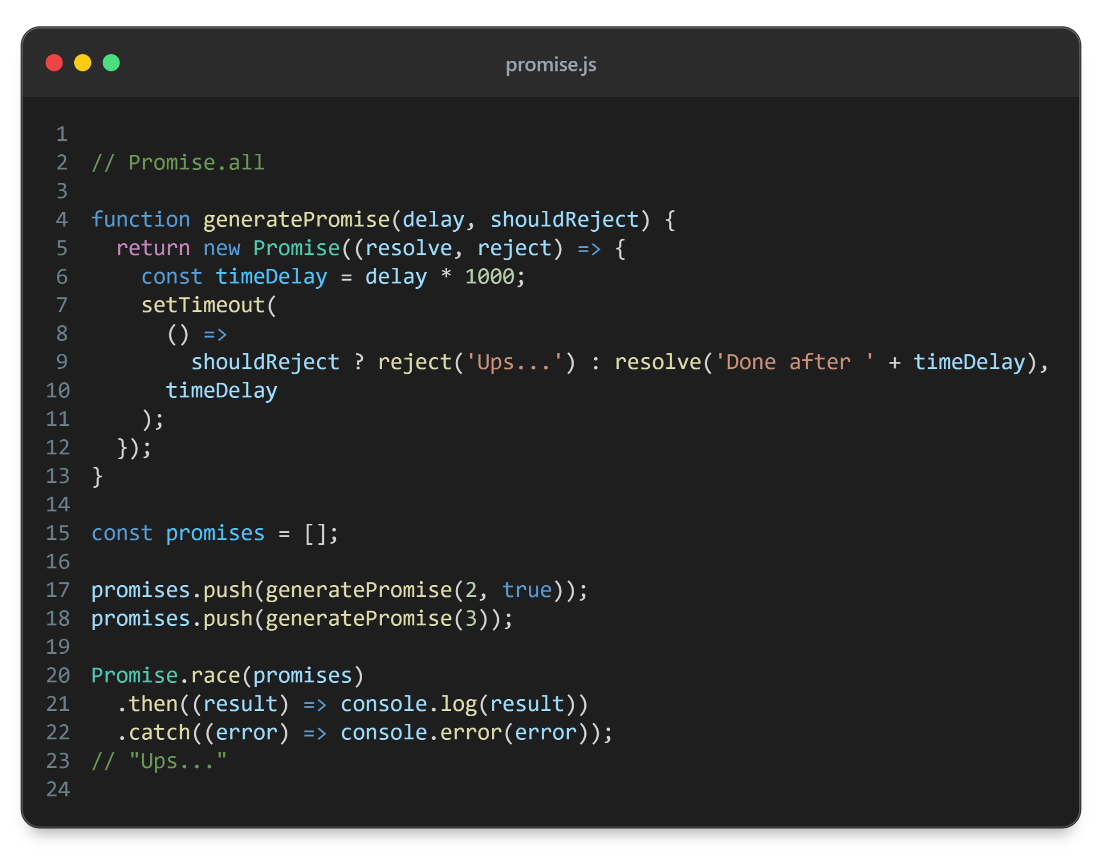

Slide 50
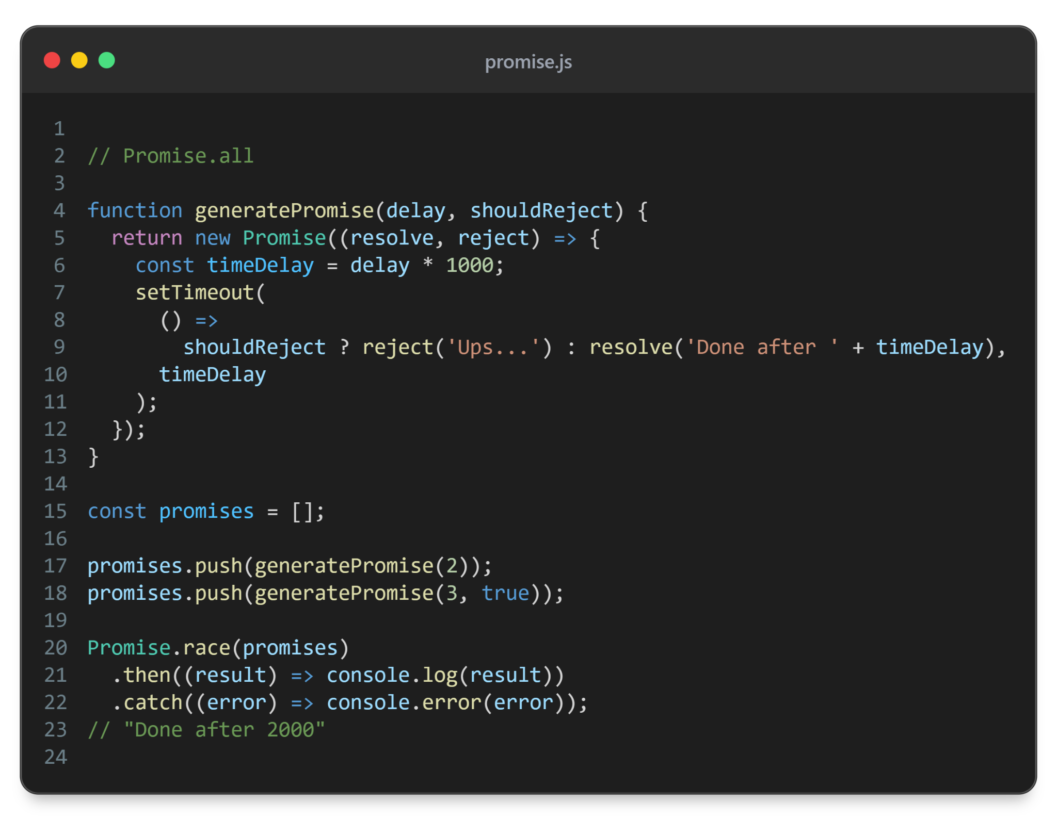

Slide 51
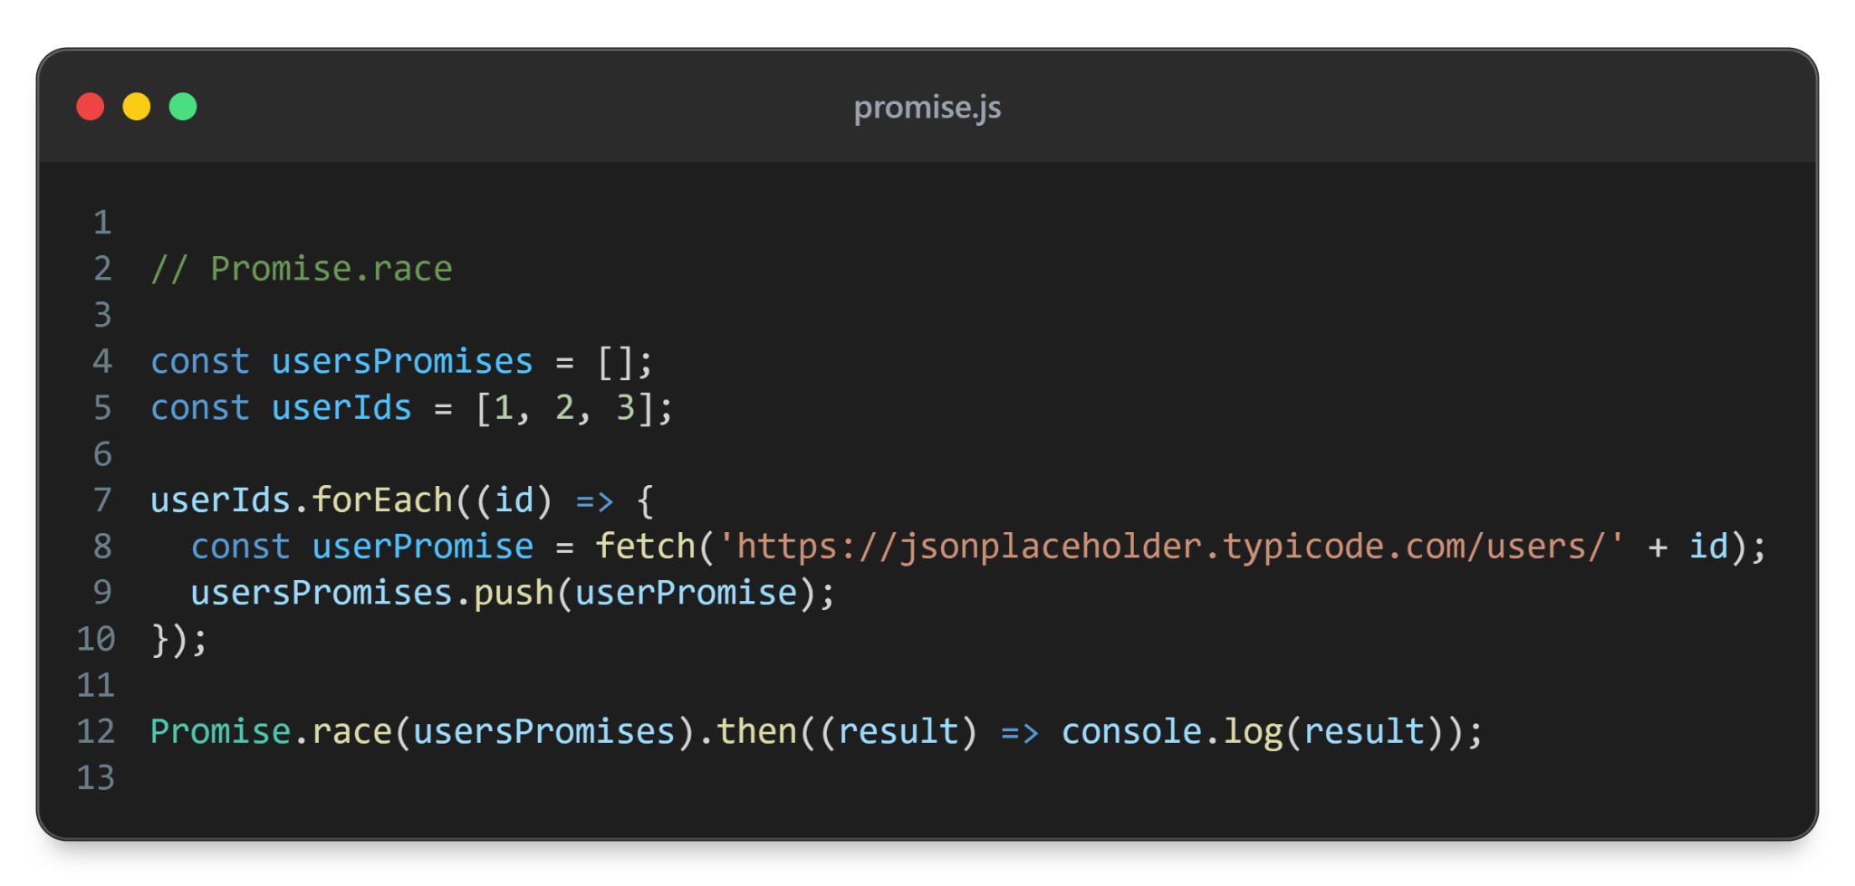

Slide 52
Promise race example
DEMO

Slide 53
Promise chaining
Promise can be chained by using .then method
.then returns a promise - you can chain another .then method

Slide 54
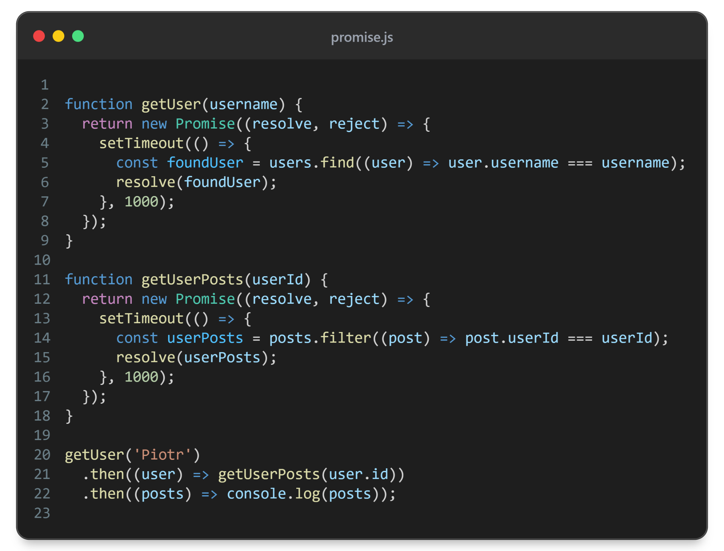
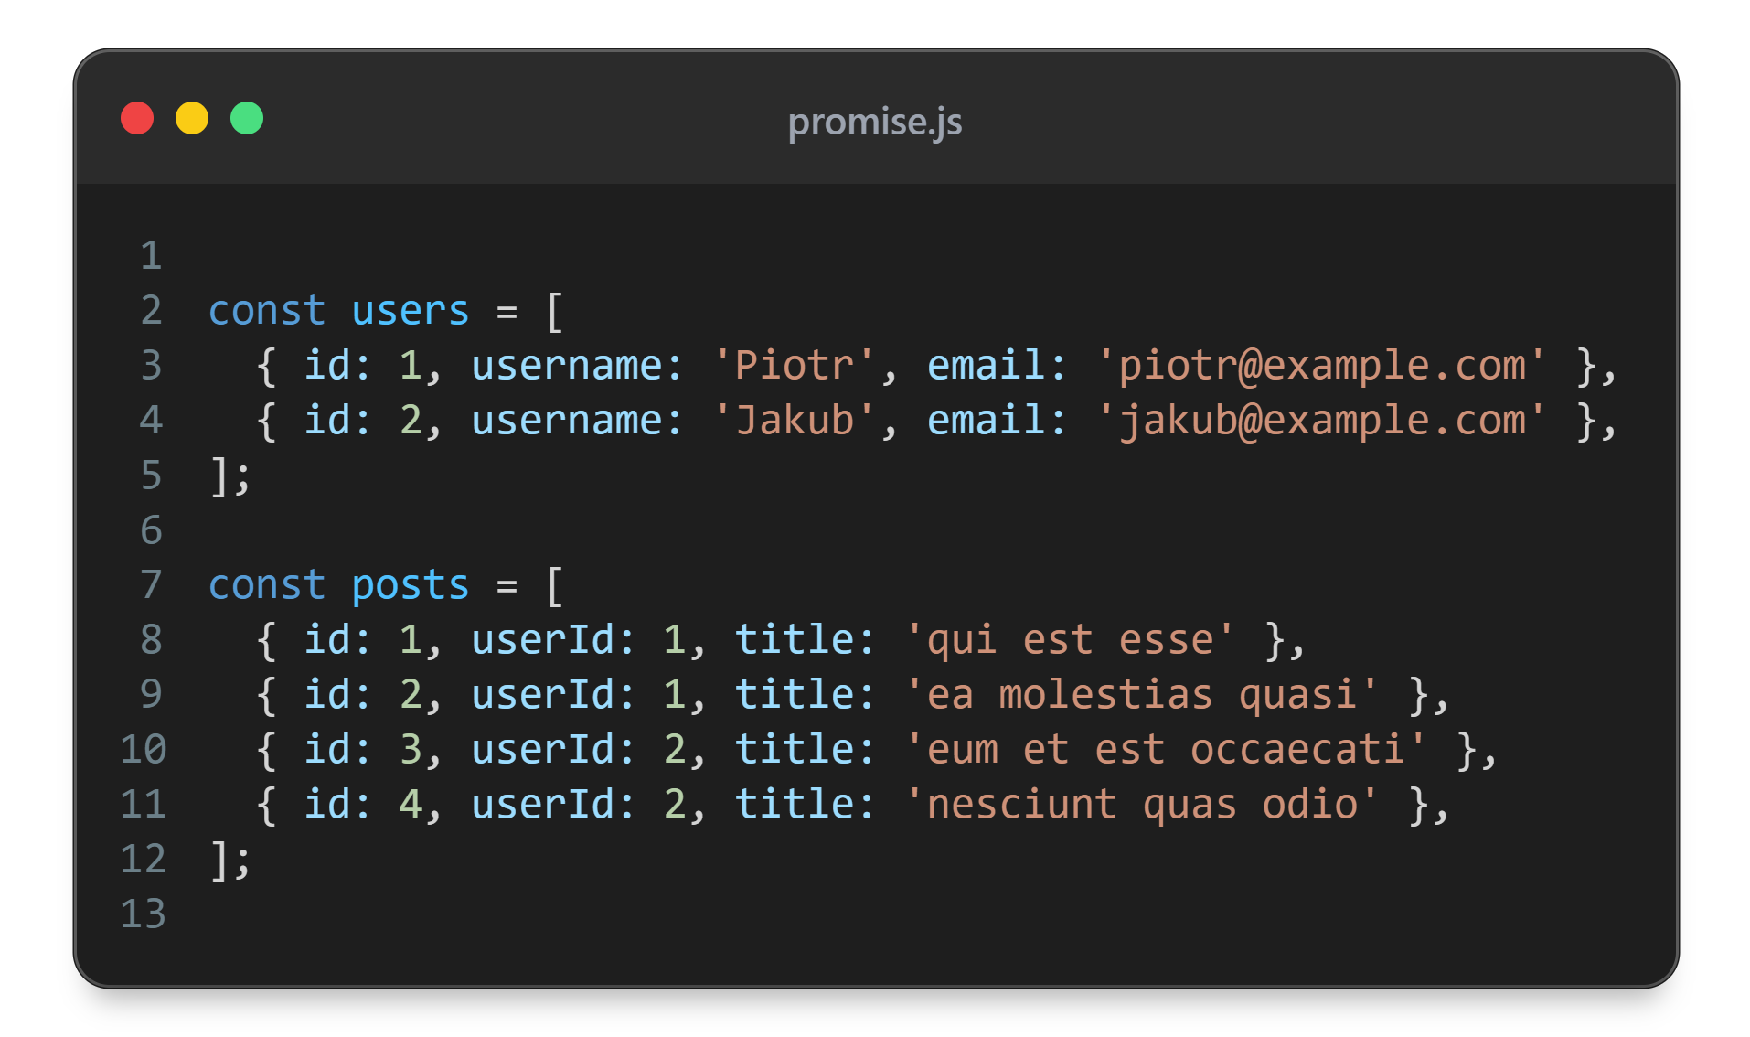

Slide 55
async - await
Sugar coating over Promises
Let’s you use Promises as if the code was synchronous
Anything the async functions returns is a promise

Slide 56
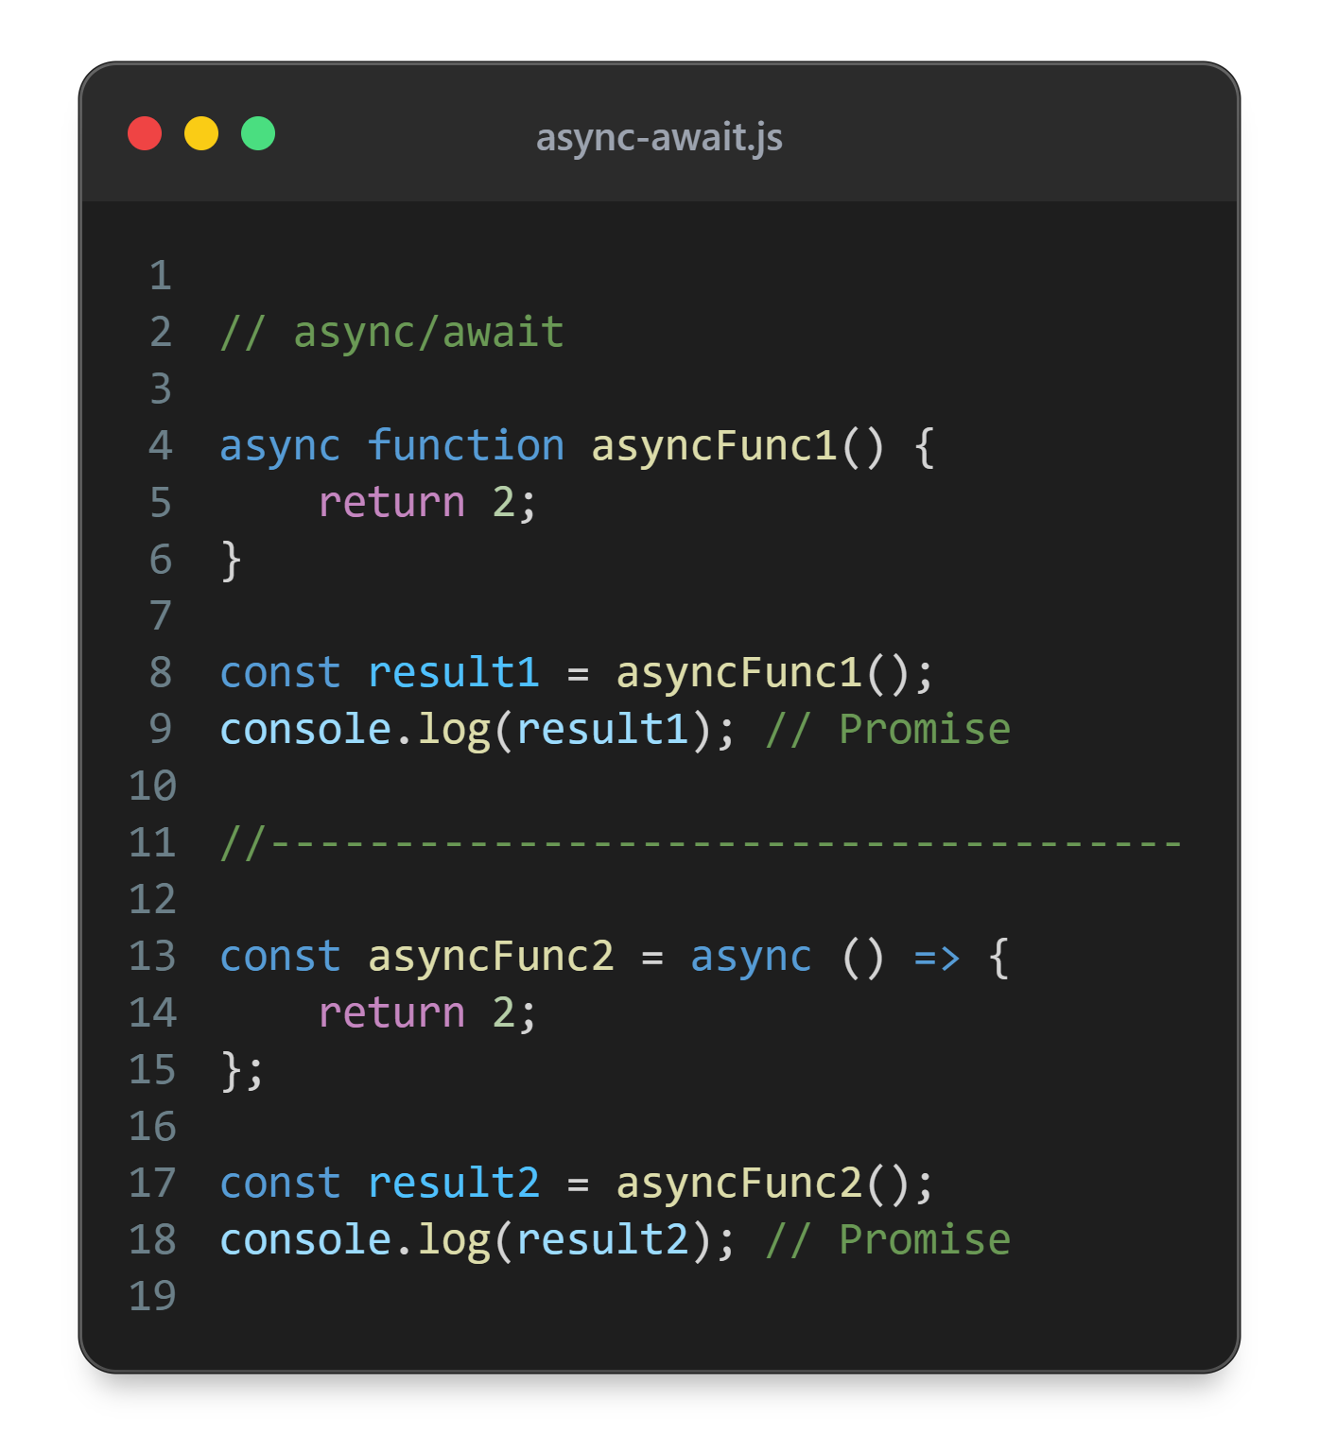

Slide 57
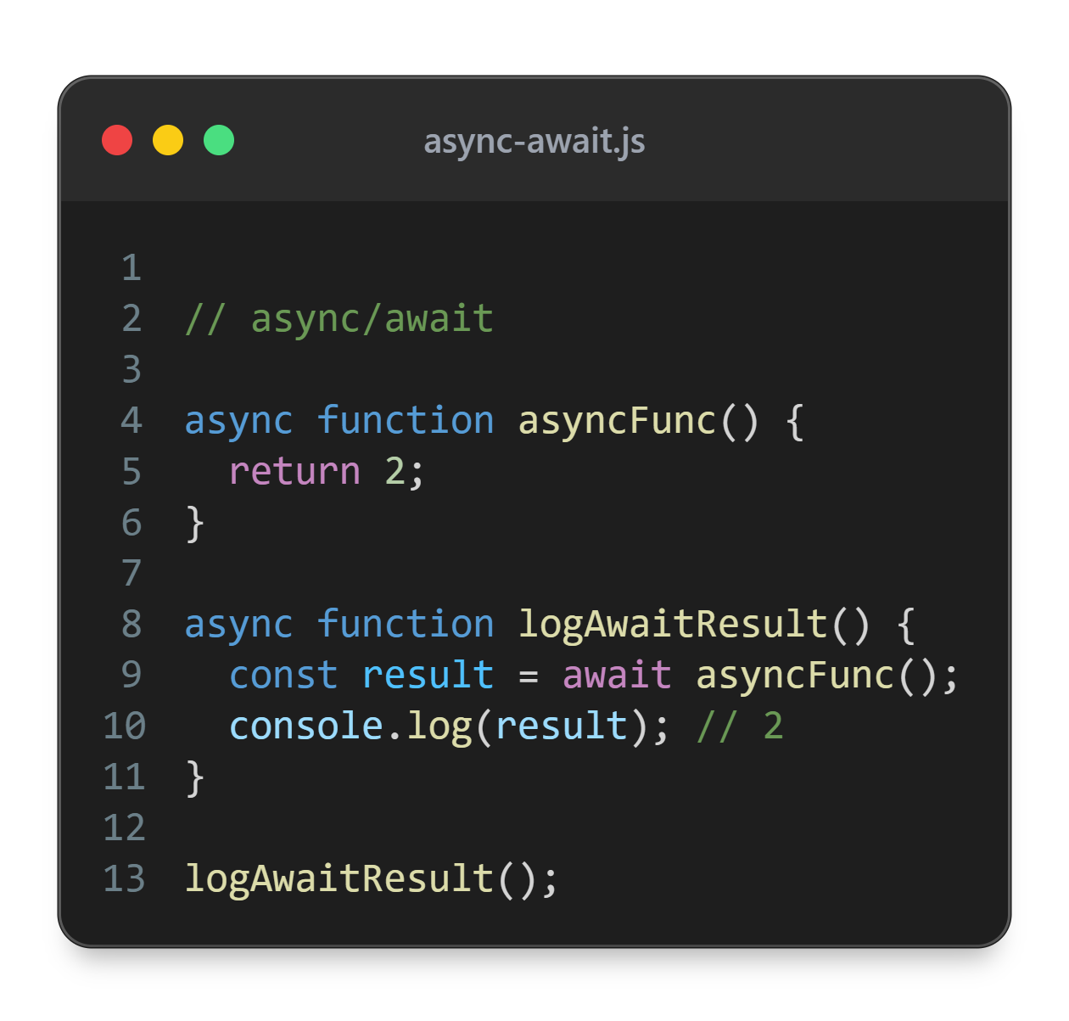

Slide 58
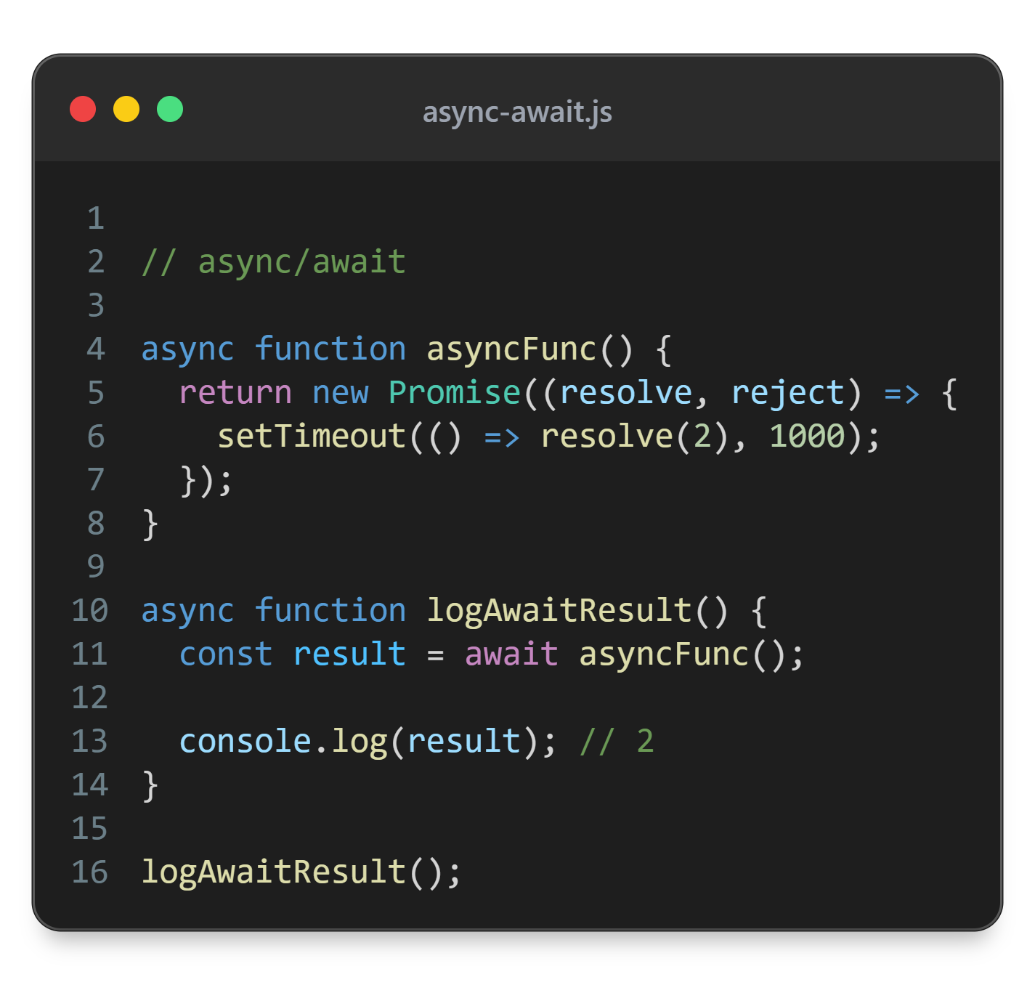

Slide 59
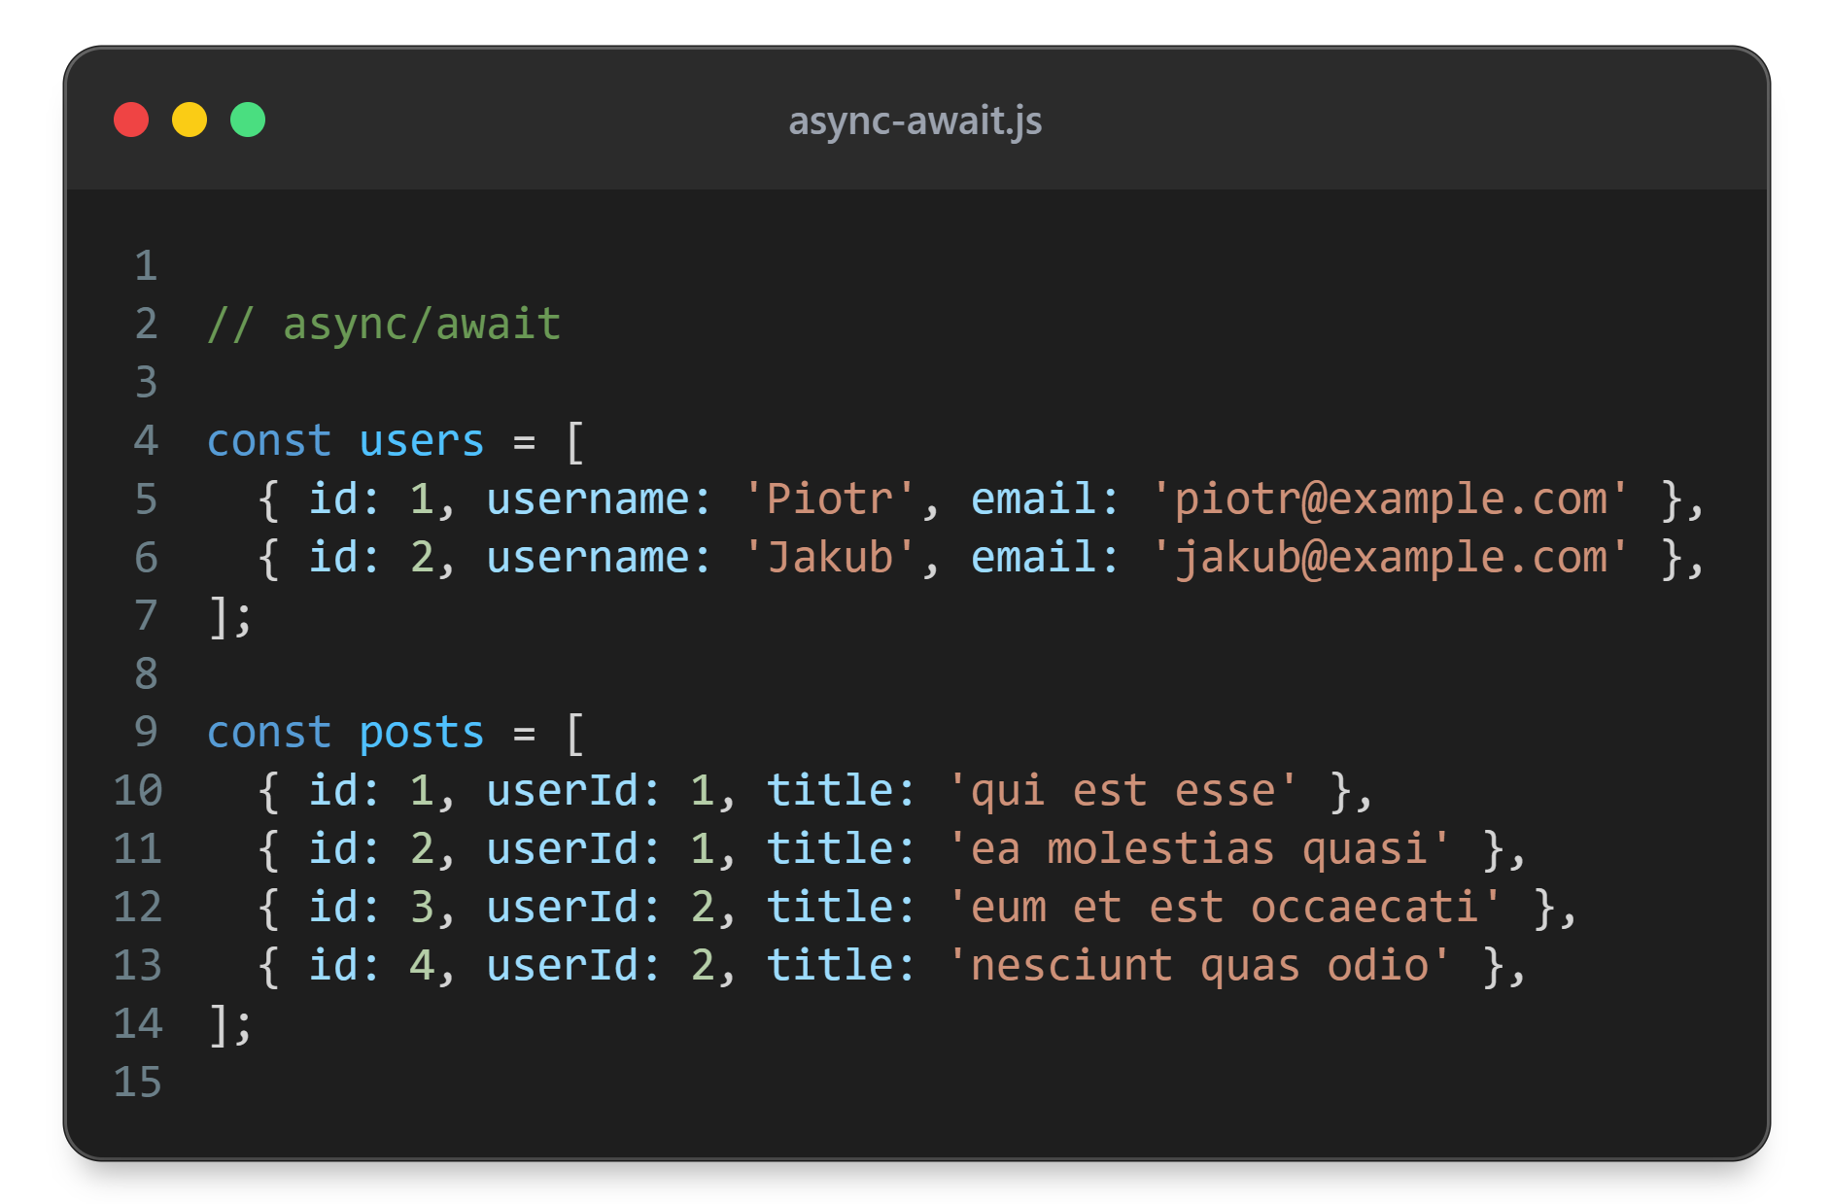

Slide 60
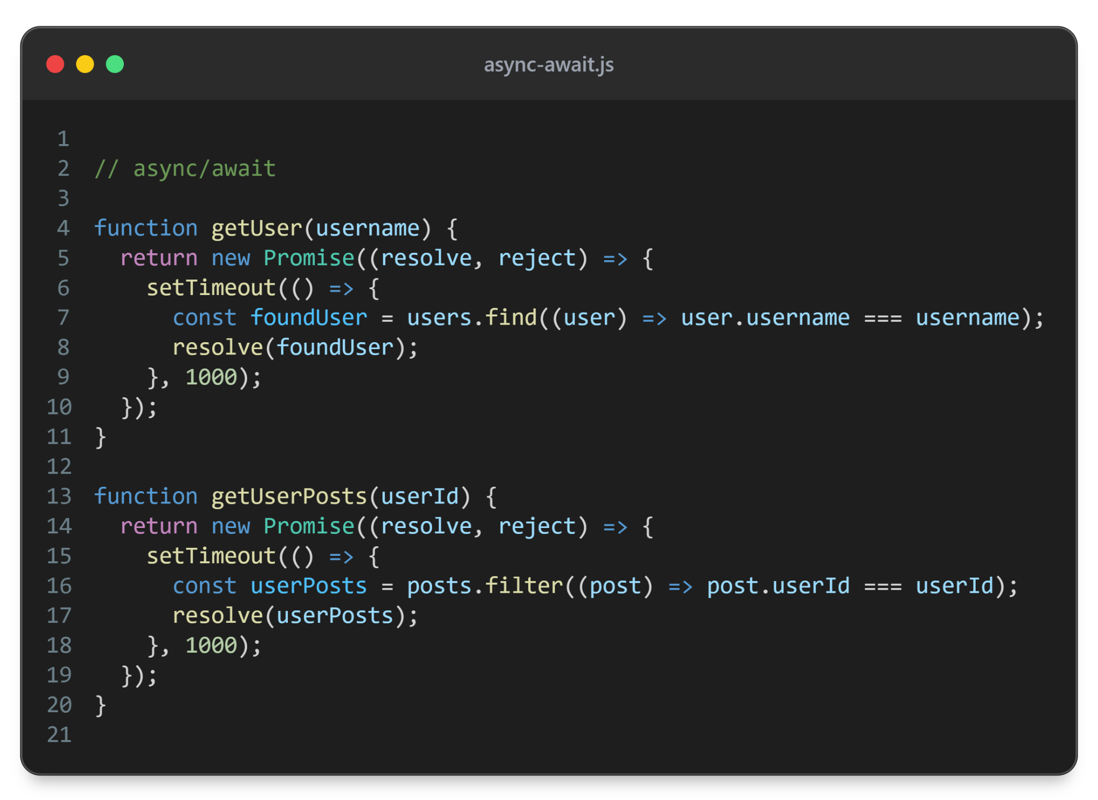

Slide 61
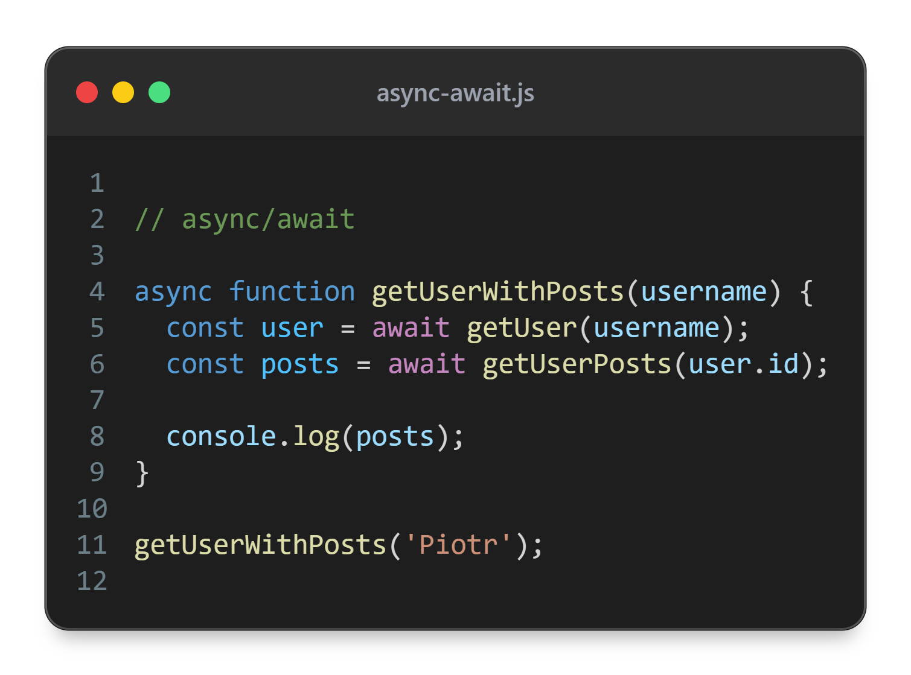

Slide 62
try - catch
Since async - await doesn’t provide a clear way of dealing with errors - we can use try catch
try block will be the code that we want to run
If any error shows up in the try block - the code in the catch block will be run

Slide 63
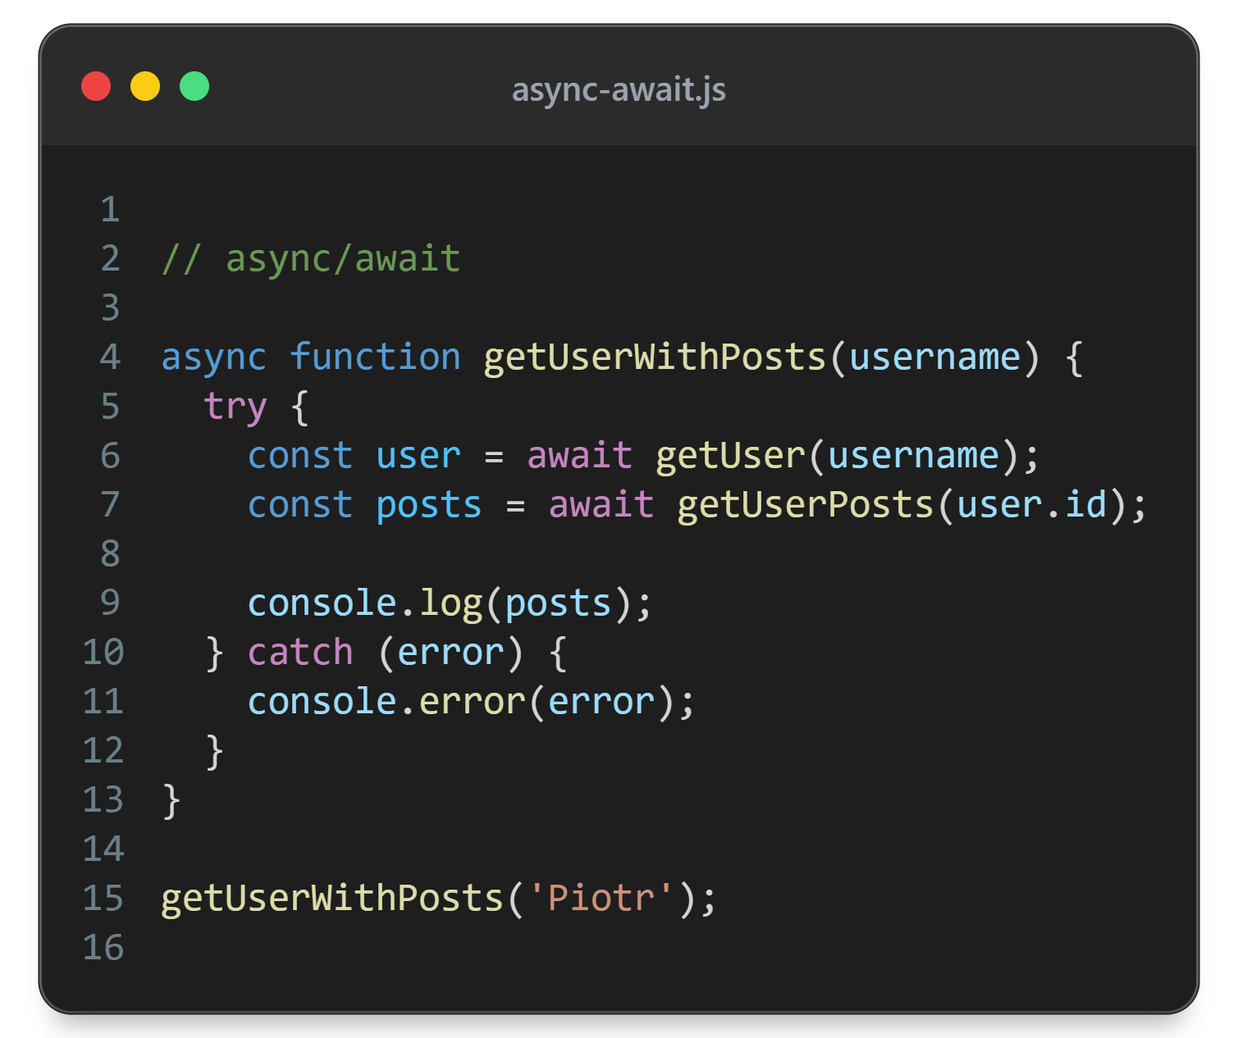

Slide 64
Error
Object thrown when runtime errors occur
Can also be used for user-defined exceptions
Error types: EvalError, RangeError, ReferenceError, SyntaxError, TypeError, URIError, AggregateError
Must be thrown if you want to catch it on .catch or catch block

Slide 65
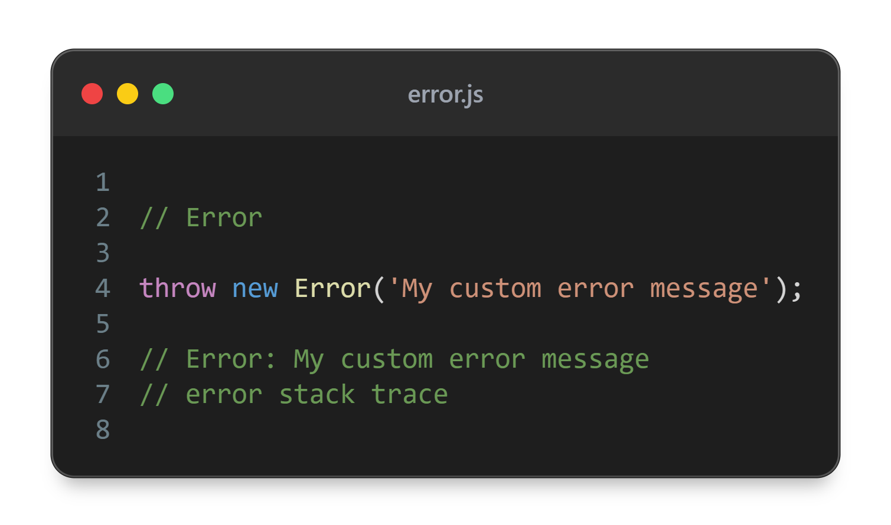

Slide 66
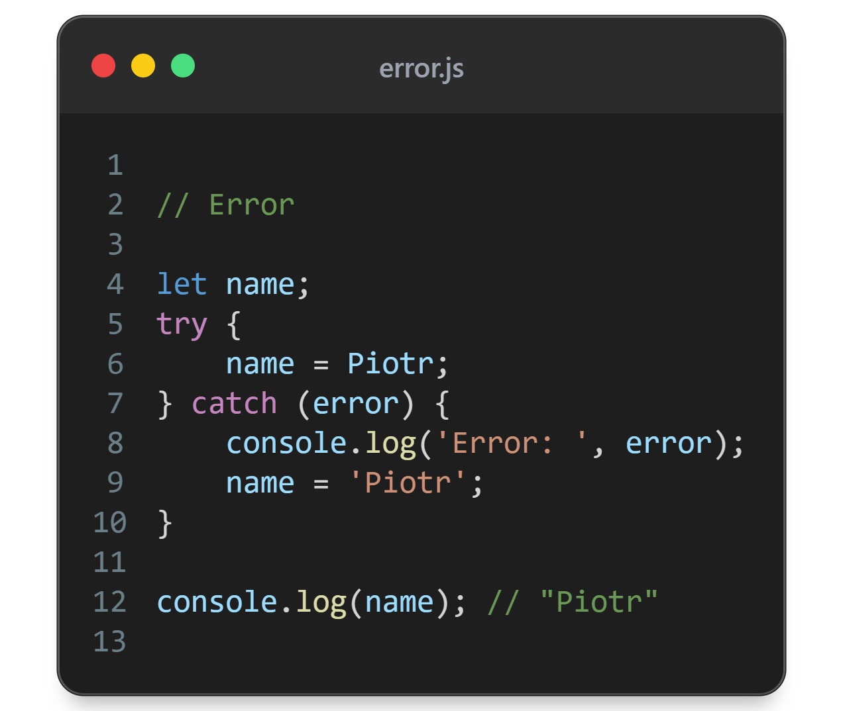

Slide 67
Error example
DEMO

Slide 68


